Slide 2
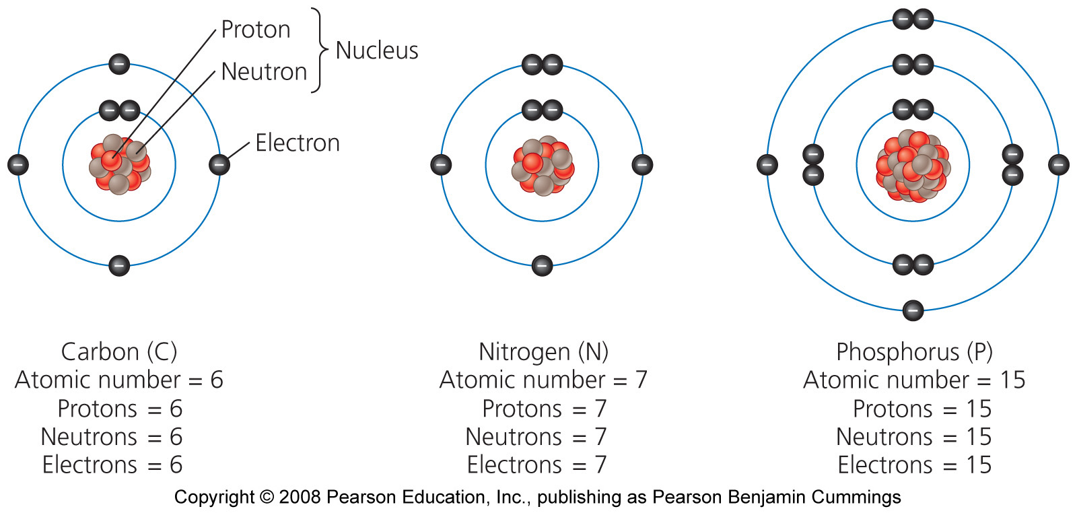
The structure of an atom

Slide 3
Radioactive decay
Half-life = the amount of time it takes for one-half of the atoms to give off radiation and decay
Different radioscopes have different half-lives ranging from fractions of a second to billions of years
Uranium-235, used in commercial nuclear power, has a half-life of 700 million years
Atoms may also gain or lose electrons to become ions, electrically charged atoms

Slide 4
Atoms are held together with bonds
Covalent bond = atoms in a molecule share electrons
For example, the atoms that bond to form H₂0
Polar covalent bonds = Atoms share electrons unequally, with one atom exerting a greater pull
The oxygen in a water molecule attracts electrons
Ionic bonds = an electron is transferred from one atom to another
Are not molecules, but are salts, such as table salt, NaCl
Solutions = no chemical bonding, but is a mixture of substances (i.e., blood, oil)

Slide 5
The carbon cycle

Slide 6
The phosphorus cycle

Slide 7
The nitrogen cycle

Slide 8
The hydrologic cycle

Slide 9
Half-Life
The half-life of radon gas is approximately four days. Four weeks after the introduction of radon into a sealed room, the fraction of the original amount remaining is closest to….

