Slide 1
Industrial demand can be reduced
Shift to processes that use less water
Wastewater recycling
Excess surface water runoff used for recharging aquifers
Patching leaky pipes
Auditing industries
Promoting conservation/education

Slide 2
Economic approaches to water conservation
End government subsidies of inefficient practices
Let the price of water reflect its true cost of extraction
Industrial uses are more profitable than agricultural
Less developed countries suffer
Privatization of water supplies
May improve efficiency
Firms have little incentive to provide access to the poor
Decentralization of water control may conserve water
Shift control to the local level

Slide 3
SOLUTIONS
Sustainable Water Use
Waste less water and subsidize water conservation
Do not deplete aquifers
Preserve water quality
Protect forests, wetlands, mountain glaciers, watersheds, and other natural systems that store and release water
Get agreements among regions and countries sharing surface water resources
Raise water prices
Slow population growth
Fig. 13-23, p. 337
Notes:
Figure 13.23
Methods for achieving more sustainable use of the earth’s water resources (Concept 13-6). Question: Which two of these solutions do you think are the most important? Why?

Slide 4
Freshwater pollution and its control
Water for human consumption and other organisms needs to be…
Disease-free
Nontoxic
Half of the world’s major rivers are seriously depleted and polluted
They poison surrounding ecosystems
Threaten the health and livelihood of people
The invisible pollution of groundwater has been called a “covert crisis”
The United Nations has estimated that by 2025, at least 3 billion of the world’s projected 7.9 billion people will lack access to safe water.

Slide 5
Nutrient pollution
Pollution = the release of matter or energy into the environment that causes undesirable impacts on the health and well-being of humans or other organisms
Nutrient pollution from fertilizers, farms, sewage, lawns, golf courses
Leads to eutrophication
Solutions
Phosphate-free detergents
Planting vegetation to increase nutrient uptake
Treat wastewater
Reduce fertilizer application

Slide 6
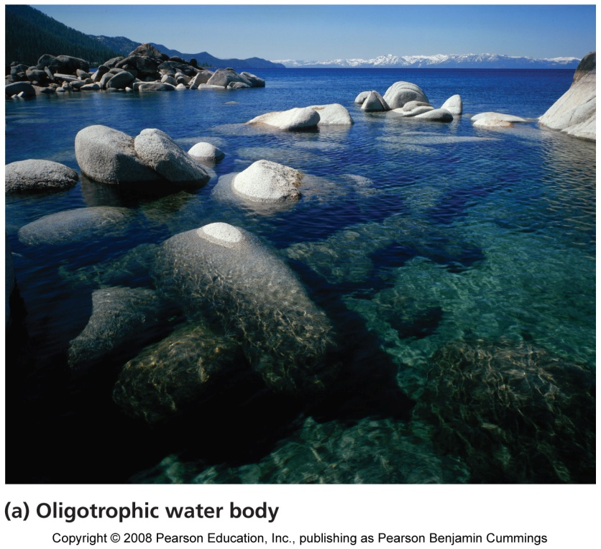
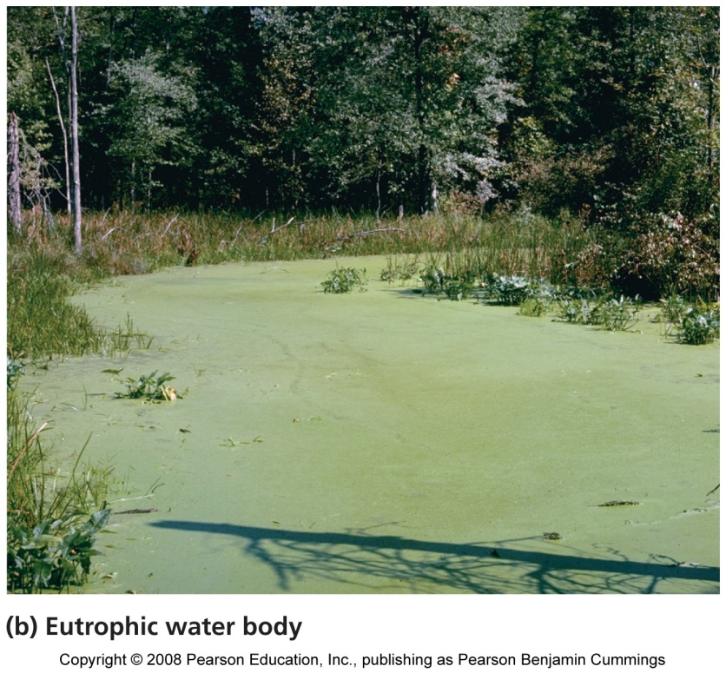
Eutrophication is a natural process, but…
Human activities dramatically increase the rate at which it occurs

Slide 7
Pathogens and waterborne diseases
Enters water supply via inadequately treated human waste and animal waste via feedlots
Causes more human health problems than any other type of water pollution
Currently, 1.1 billion people are without safe drinking water
Fecal coliform bacteria indicate fecal contamination of water
The water can hold other pathogens, such as giardiasis, typhoid, hepatitis A
Solutions:
Treat sewage
Disinfect drinking water
Public education to encourage personal hygiene
Government enforcement of regulations

Slide 8
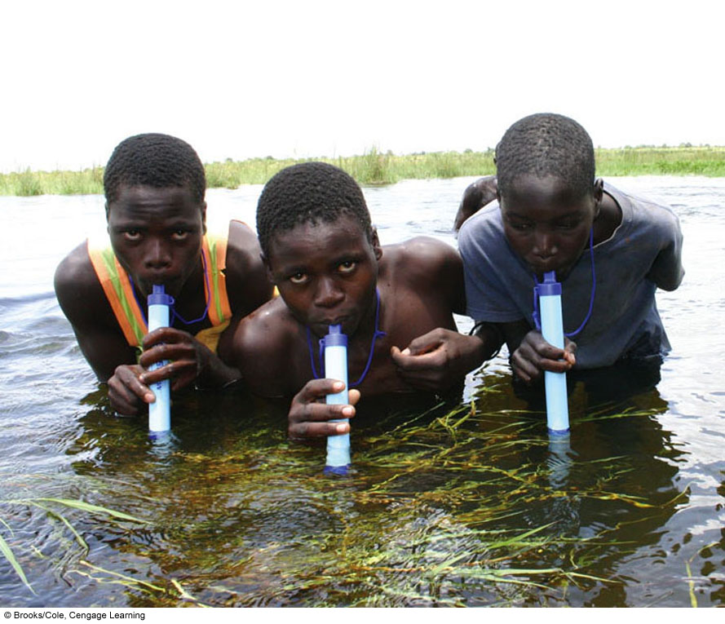
The LifeStraw: Personal Water Purification Device
Notes:
8

Slide 9
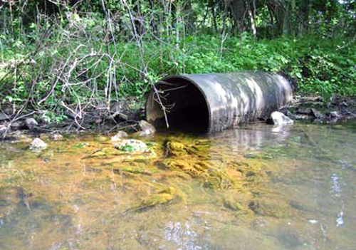
Toxic chemicals
From natural and synthetic sources
Pesticides, petroleum products, synthetic chemicals
Arsenic, lead, mercury, acid rain, acid drainage from mines
Effects include: poisoning animals and plants, altering aquatic ecosystems, and affecting human health
Solutions:
Legislating and enforcing more stringent regulations of industry
Modify industrial processes
Modify our purchasing decisions

Slide 10
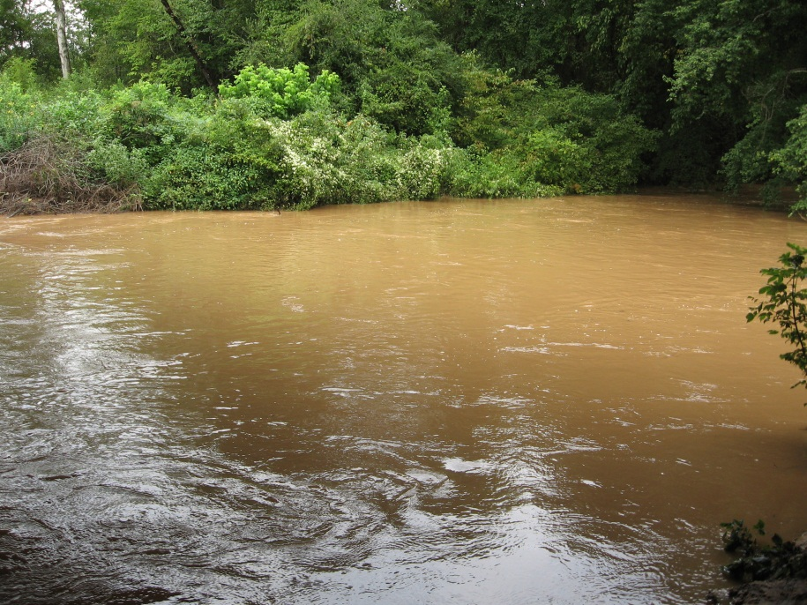
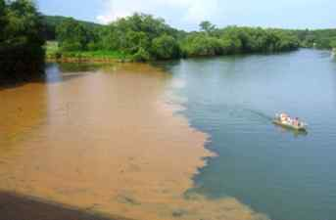
Sediment pollution
Sediment can impair aquatic ecosystems
Clear-cutting, mining, poor cultivation practices
Dramatically changes aquatic habitats, and fish may not survive
Solutions: better management of farms and forests; avoid large-scale disturbance of vegetation

Slide 11
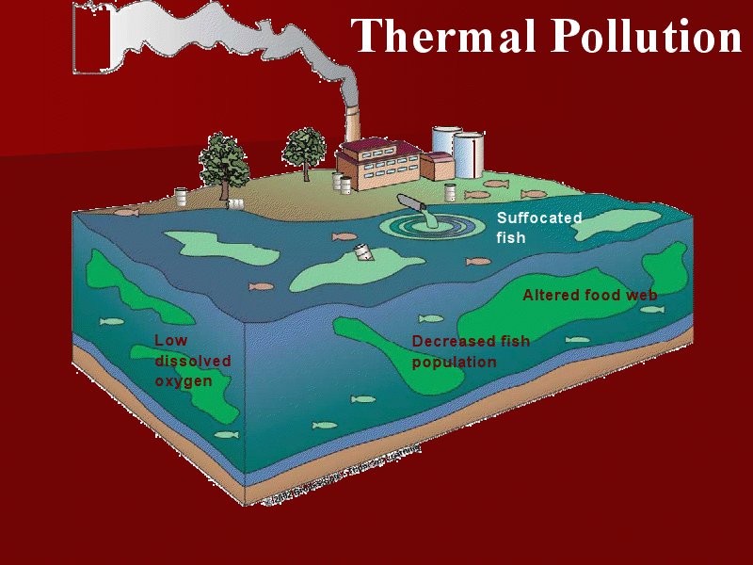
Thermal pollution
Warmer water holds less oxygen
Dissolved oxygen decreases as temperature increases
Industrial cooling heats water
Removing streamside cover also raises water temperature
Water that is too cold causes problems
Water at the bottom of reservoirs is colder
When water is released, downstream water temperatures drop suddenly and may kill aquatic organisms

Slide 12
Water Pollution Comes from Point and Nonpoint Sources
Point sources
Located at specific places
Often discharge pollutants through drain pipes, sewer lines
Easy to identify, monitor, and regulate
Examples: factories, sewage treatment plants, underground mines, oil tankers
Nonpoint sources
Broad, diffuse areas
Difficult to identify and control
Expensive to clean up
Examples: runoff of chemicals and sediment from cropland, livestock feedlots, golf courses, parking lots, urban streets
Notes:
12

Slide 13
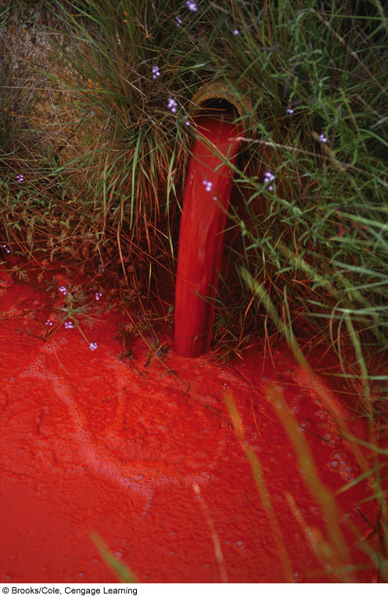
Point Source
Non-Point Source

Slide 14
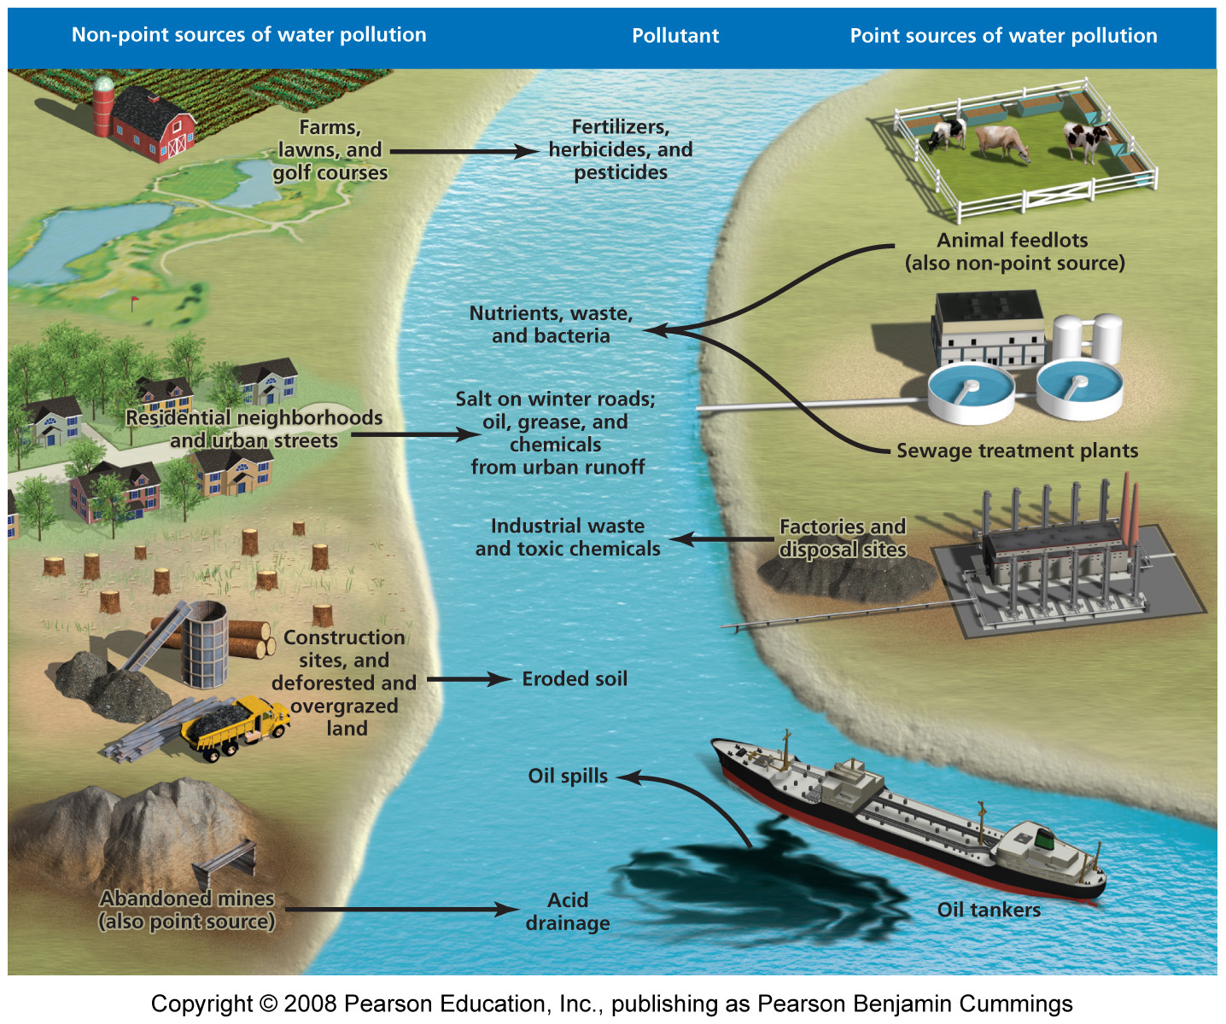
Freshwater pollution sources

Slide 15
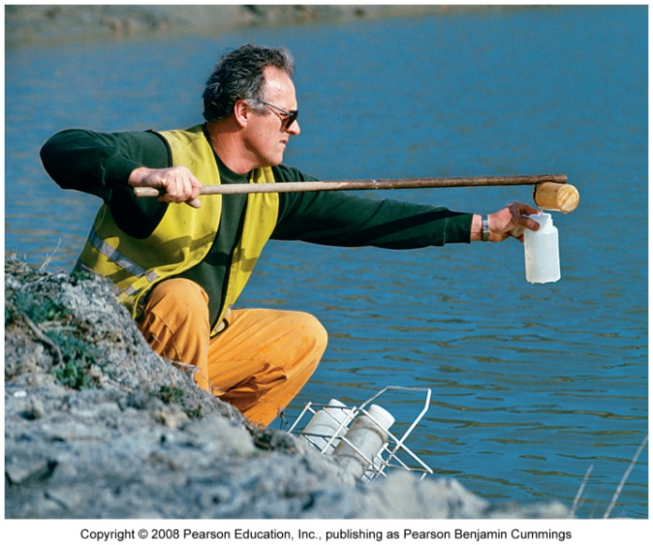
Indicators of water quality
Scientists measure properties of water to characterize its quality
Biological indicators: presence of fecal coliform bacteria and other disease-causing organisms
Chemical indicators: pH, nutrient concentration, taste, odor, hardness, dissolved oxygen
Physical indicators: turbidity, color, temperature

Slide 16
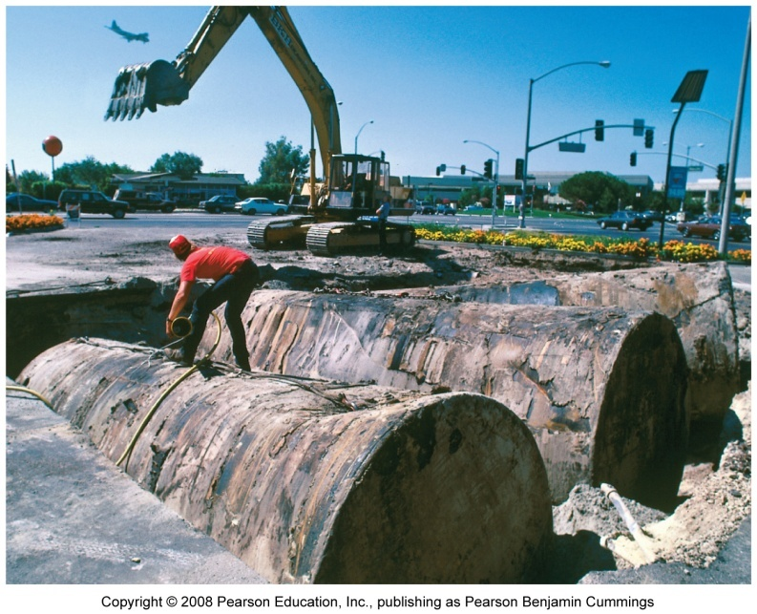
Sources of groundwater pollution
Some toxic chemicals occur naturally
Aluminum, fluoride, sulfates
Pollution from human causes
Wastes leach through soils
Pathogens enter through improperly designed wells
Hazardous wastes are pumped into the ground
Underground storage septic tanks may leak

Slide 17
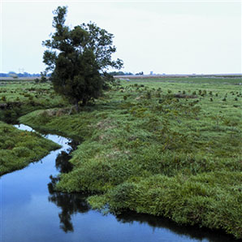
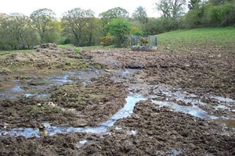
Agriculture and industries pollute groundwater
Agricultural pollution
Nitrates from fertilizers
Pesticides were detected in more than half of the shallow aquifers tested
Manufacturing industries and military sites have been heavy polluters

Slide 18
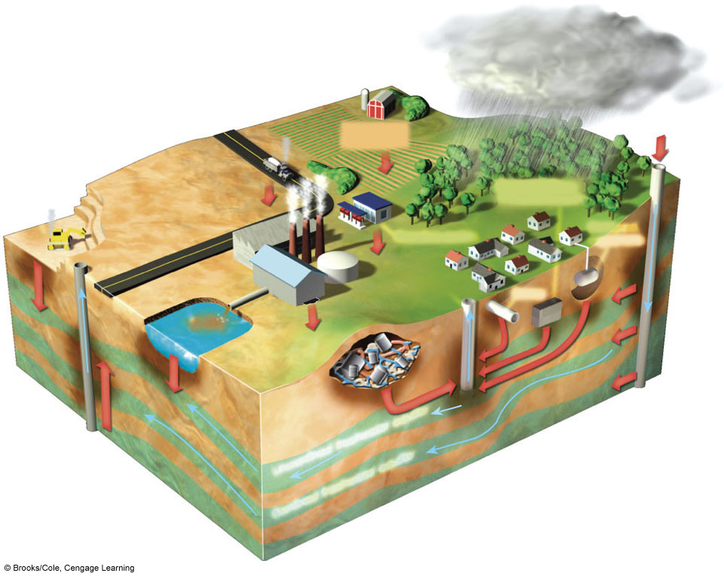
Sources of Groundwater
Contamination in the U.S.
Polluted air
Hazardous waste injection well
Pesticides and fertilizers
Coal strip mine runoff
Deicing road salt
Buried gasoline and solvent tanks
Gasoline station
Cesspool, septic tank
Pumping well
Water pumping well
Waste lagoon
Sewer
Landfill
Accidental spills
Leakage from faulty casing
Discharge
Unconfined freshwater aquifer
Confined aquifer
Confined freshwater aquifer
Groundwater flow
Fig. 20-11, p. 542
Notes:
Figure 20.11
Natural capital degradation: principal sources of groundwater contamination in the United States (Concept 20-3A). Another source is saltwater intrusion from excessive groundwater withdrawal in coastal areas. (Figure is not drawn to scale.) Question: What are three sources shown in this picture that might be affecting groundwater in your area?

Slide 19
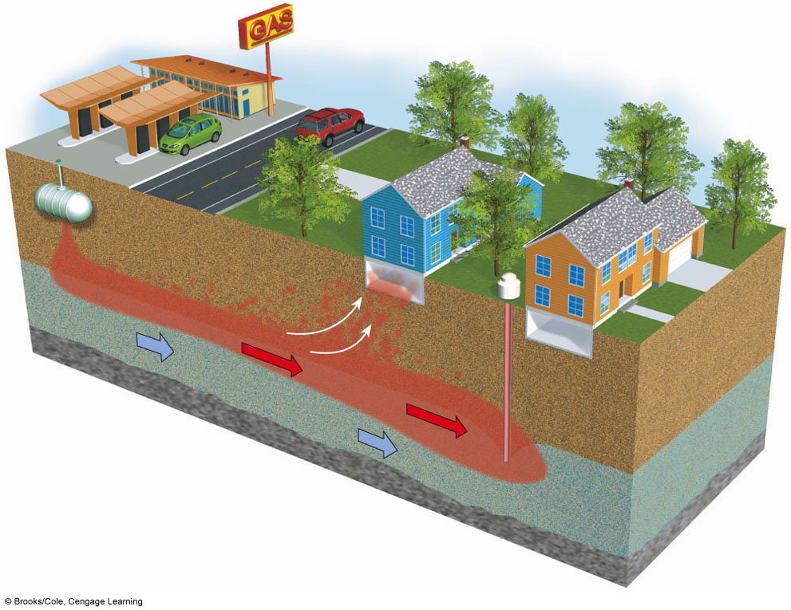
Groundwater Contamination
from a Leaking Gasoline Tank
Leaking tank
Aquifer
Bedrock
Water table
Groundwater flow
Gasoline leakage plume (liquid phase)
Free gasoline dissolves in groundwater (dissolved phase)
Migrating vapor phase
Water well
Contaminant plume moves with the groundwater
Fig. 20-12, p. 543
Notes:
Figure 20.12
Natural capital degradation: groundwater contamination from a leaking gasoline tank. As the contaminated water spreads from its source in a widening plume, it can be extracted by wells used to provide water for drinking and irrigation.

Slide 20
U.S. Water Pollution Laws
The U.S. Clean Water Act (1977)
Mandates the restoration and maintenance of the chemical, physical, and biological integrity of the nation’s waters.
Targeted Industrial Discharges, Addressed Point Source Pollution
Safe Drinking Water Act (1974)
Requires minimum safety standards for community water supplies. EPA sets the standards
Notes:
20

Slide 21
Treating wastewater
Wastewater = water that has been used by people in some way
Sewage, showers, sinks, manufacturing, storm water runoff
Septic systems = the most popular method of wastewater disposal in rural areas
Underground septic tanks separate solids and oils from wastewater
The water drains into a drain field, where microbes decompose the water
Solid waste needs to be periodically pumped and landfilled

Slide 22
Municipal sewer systems
In populated areas, sewer systems carry wastewater
Physical, chemical, and biological water treatment
Primary treatment = the physical removal of contaminants in settling tanks (clarifiers)
Secondary treatment = water is stirred and aerated so aerobic bacteria degrade organic pollutants
Water treated with chlorine or ozone is piped into rivers or the ocean
Some reclaimed water is used for irrigation, lawns, or industry

Slide 23
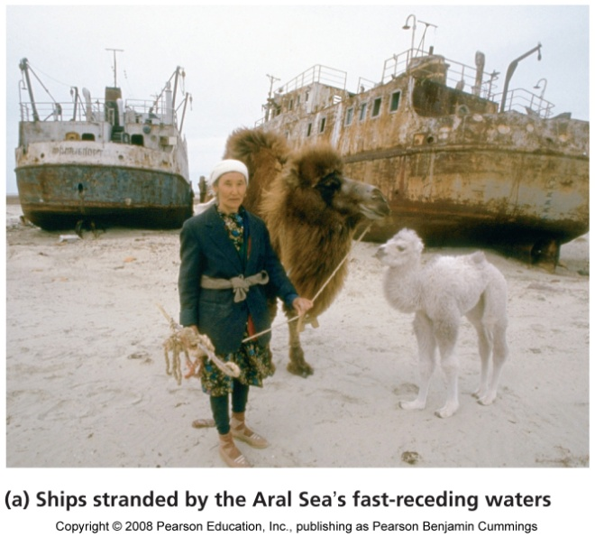
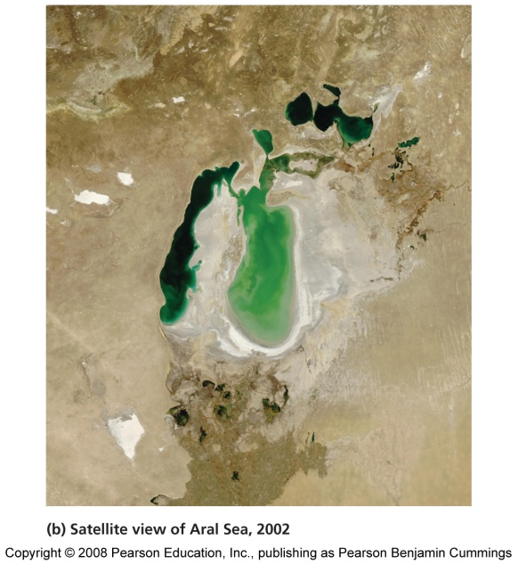
The Aral Sea
Once the fourth-largest lake on Earth
It has lost more than 80% of its volume in just 45 years
The two rivers leading into the Aral Sea were diverted to irrigate cotton fields
Consequences of a shrinking sea
60,000 fishing jobs are gone
Pesticide-laden dust from the lake bed is blown into the air
The cotton cannot bring back the region’s economy

Slide 24
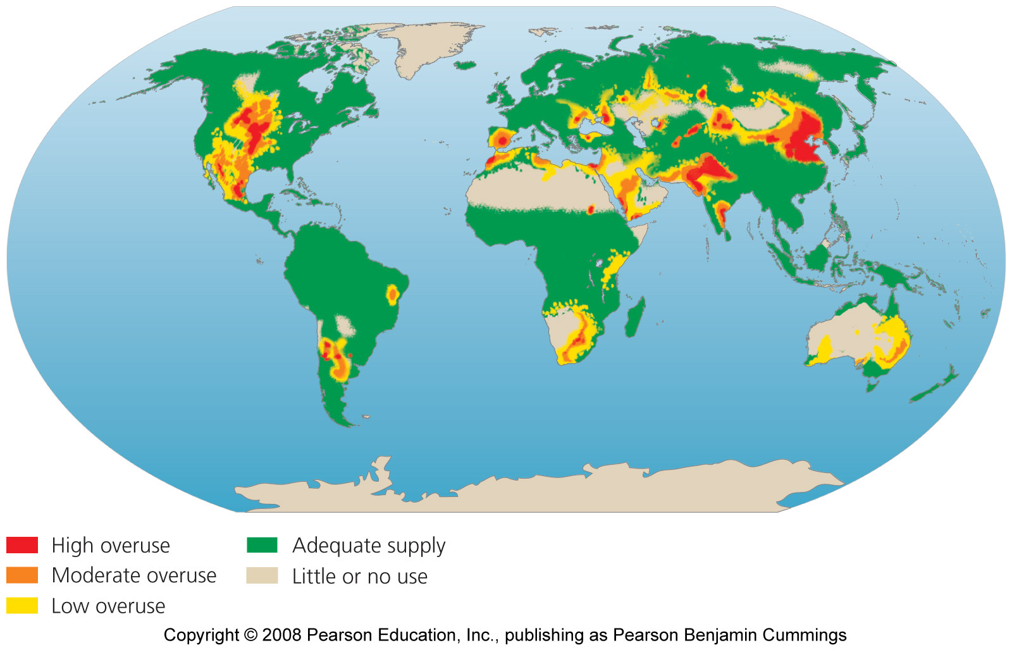
Areas where water use exceeds supply

Slide 25
Will we see a future of water wars?
Freshwater depletion leads to shortages, which can lead to conflict
261 major rivers cross national borders
Water is a key element in hostilities among Israel, Palestinians, and neighboring countries
Many nations have cooperated with neighbors to resolve disputes

Slide 26
Desalinization “makes” more water
Desalinization = the removal of salt from seawater or other water of marginal quality
Distilling = hastens evaporation and condenses the vapor
Reverse osmosis = forces water through membranes to filter out salts
Desalinization facilities operate mostly in the arid Middle East
It is expensive, requires fossil fuels, and produces concentrated salty water

Slide 27
The world’s largest reverse osmosis plant
Near Yuma, Arizona
Intended to reduce the salinity of irrigation runoff
Too expensive to operate and closed after 8 months

Slide 28
Agricultural demand can be reduced
Look first for ways to decrease agricultural demand
Lining irrigation canals
Low-pressure spray irrigation that spray water downward
Drip irrigation systems that target individual plants
Match crops to land and climate
Selective breeding and genetic modification to raise crops that require less water

Slide 29
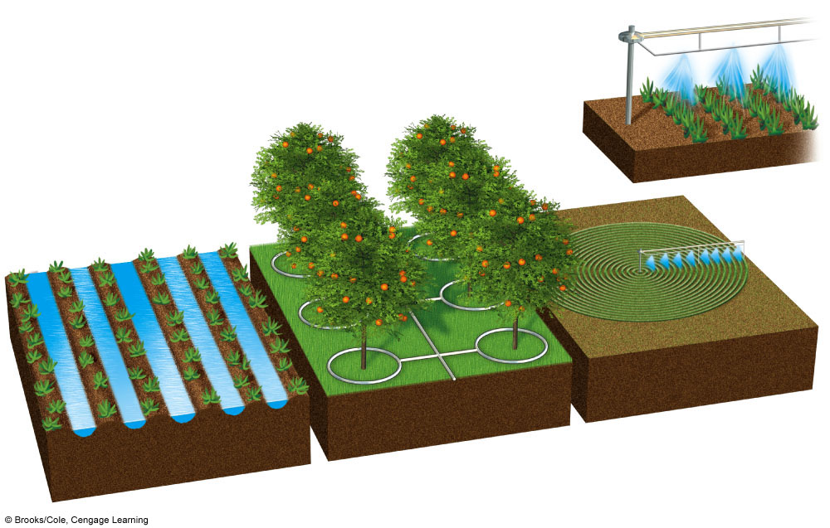
Major Irrigation Systems
Center pivot
(efficiency 80% with low-pressure sprinkler and 90–95% with LEPA sprinkler)
Drip irrigation
(efficiency 90–95%)
Gravity flow
(efficiency 60% and 80% with surge valves)
Above- or below-ground pipes or tubes deliver water to individual plant roots.
Water usually pumped from underground and sprayed from mobile boom with sprinklers.
Water usually comes from an aqueduct system or a nearby river.
Fig. 13-20, p. 335
Notes:
Figure 13.20
Major irrigation systems. Because of high initial costs, center-pivot irrigation and drip irrigation are not widely used. The development of new, low-cost, drip-irrigation systems may change this situation.

Slide 30
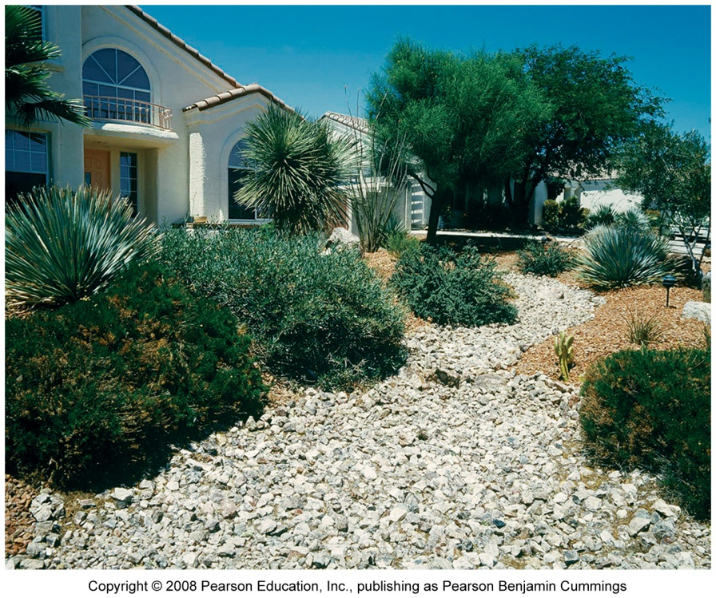
Residential demand can be reduced
Install low-flow faucets, showerheads, washing machines, and toilets
Water lawns at night, when evaporation is minimal
Eat less meat
Xeriscaping = landscaping using plants adapted to arid conditions

Slide 31
Industrial demand can be reduced
Shift to processes that use less water
Wastewater recycling
Excess surface water runoff used for recharging aquifers
Patching leaky pipes
Auditing industries
Promoting conservation/education

Slide 32
Economic approaches to water conservation
End government subsidies of inefficient practices
Let the price of water reflect its true cost of extraction
Industrial uses are more profitable than agricultural
Less developed countries suffer
Privatization of water supplies
May improve efficiency
Firms have little incentive to provide access to the poor
Decentralization of water control may conserve water
Shift control to the local level

Slide 33
SOLUTIONS
Sustainable Water Use
Waste less water and subsidize water conservation
Do not deplete aquifers
Preserve water quality
Protect forests, wetlands, mountain glaciers, watersheds, and other natural systems that store and release water
Get agreements among regions and countries sharing surface water resources
Raise water prices
Slow population growth
Fig. 13-23, p. 337
Notes:
Figure 13.23
Methods for achieving more sustainable use of the earth’s water resources (Concept 13-6). Question: Which two of these solutions do you think are the most important? Why?

Slide 34
Freshwater pollution and its control
Water for human consumption and other organisms needs to be…
Disease-free
Nontoxic
Half of the world’s major rivers are seriously depleted and polluted
They poison surrounding ecosystems
Threaten the health and livelihood of people
The invisible pollution of groundwater has been called a “covert crisis”
The United Nations has estimated that by 2025, at least 3 billion of the world’s projected 7.9 billion people will lack access to safe water.

Slide 35
Nutrient pollution
Pollution = the release of matter or energy into the environment that causes undesirable impacts on the health and well-being of humans or other organisms
Nutrient pollution from fertilizers, farms, sewage, lawns, golf courses
Leads to eutrophication
Solutions
Phosphate-free detergents
Planting vegetation to increase nutrient uptake
Treat wastewater
Reduce fertilizer application

Slide 36
Eutrophication is a natural process, but…
Human activities dramatically increase the rate at which it occurs

Slide 37
Pathogens and waterborne diseases
Enters water supply via inadequately treated human waste and animal waste via feedlots
Causes more human health problems than any other type of water pollution
Currently, 1.1 billion people are without safe drinking water
Fecal coliform bacteria indicate fecal contamination of water
The water can hold other pathogens, such as giardiasis, typhoid, hepatitis A
Solutions:
Treat sewage
Disinfect drinking water
Public education to encourage personal hygiene
Government enforcement of regulations

Slide 38
The LifeStraw: Personal Water Purification Device
Notes:
38

Slide 39
Toxic chemicals
From natural and synthetic sources
Pesticides, petroleum products, synthetic chemicals
Arsenic, lead, mercury, acid rain, acid drainage from mines
Effects include: poisoning animals and plants, altering aquatic ecosystems, and affecting human health
Solutions:
Legislating and enforcing more stringent regulations of industry
Modify industrial processes
Modify our purchasing decisions

Slide 40
Sediment pollution
Sediment can impair aquatic ecosystems
Clear-cutting, mining, poor cultivation practices
Dramatically changes aquatic habitats, and fish may not survive
Solutions: better management of farms and forests; avoid large-scale disturbance of vegetation

Slide 41
Thermal pollution
Warmer water holds less oxygen
Dissolved oxygen decreases as temperature increases
Industrial cooling heats water
Removing streamside cover also raises water temperature
Water that is too cold causes problems
Water at the bottom of reservoirs is colder
When water is released, downstream water temperatures drop suddenly and may kill aquatic organisms

Slide 42
Water Pollution Comes from Point and Nonpoint Sources
Point sources
Located at specific places
Often discharge pollutants through drain pipes, sewer lines
Easy to identify, monitor, and regulate
Examples: factories, sewage treatment plants, underground mines, oil tankers
Nonpoint sources
Broad, diffuse areas
Difficult to identify and control
Expensive to clean up
Examples: runoff of chemicals and sediment from cropland, livestock feedlots, golf courses, parking lots, urban streets
Notes:
42

Slide 43
Point Source
Non-Point Source

Slide 44
Freshwater pollution sources

Slide 45
Indicators of water quality
Scientists measure properties of water to characterize its quality
Biological indicators: presence of fecal coliform bacteria and other disease-causing organisms
Chemical indicators: pH, nutrient concentration, taste, odor, hardness, dissolved oxygen
Physical indicators: turbidity, color, temperature

Slide 46
Sources of groundwater pollution
Some toxic chemicals occur naturally
Aluminum, fluoride, sulfates
Pollution from human causes
Wastes leach through soils
Pathogens enter through improperly designed wells
Hazardous wastes are pumped into the ground
Underground storage septic tanks may leak

Slide 47
Agriculture and industries pollute groundwater
Agricultural pollution
Nitrates from fertilizers
Pesticides were detected in more than half of the shallow aquifers tested
Manufacturing industries and military sites have been heavy polluters

Slide 48
Sources of Groundwater
Contamination in the U.S.
Polluted air
Hazardous waste injection well
Pesticides and fertilizers
Coal strip mine runoff
Deicing road salt
Buried gasoline and solvent tanks
Gasoline station
Cesspool, septic tank
Pumping well
Water pumping well
Waste lagoon
Sewer
Landfill
Accidental spills
Leakage from faulty casing
Discharge
Unconfined freshwater aquifer
Confined aquifer
Confined freshwater aquifer
Groundwater flow
Fig. 20-11, p. 542
Notes:
Figure 20.11
Natural capital degradation: principal sources of groundwater contamination in the United States (Concept 20-3A). Another source is saltwater intrusion from excessive groundwater withdrawal in coastal areas. (Figure is not drawn to scale.) Question: What are three sources shown in this picture that might be affecting groundwater in your area?

Slide 49
Groundwater Contamination
from a Leaking Gasoline Tank
Leaking tank
Aquifer
Bedrock
Water table
Groundwater flow
Gasoline leakage plume (liquid phase)
Free gasoline dissolves in groundwater (dissolved phase)
Migrating vapor phase
Water well
Contaminant plume moves with the groundwater
Fig. 20-12, p. 543
Notes:
Figure 20.12
Natural capital degradation: groundwater contamination from a leaking gasoline tank. As the contaminated water spreads from its source in a widening plume, it can be extracted by wells used to provide water for drinking and irrigation.

Slide 50
U.S. Water Pollution Laws
The U.S. Clean Water Act (1977)
Mandates the restoration and maintenance of the chemical, physical, and biological integrity of the nation’s waters.
Targeted Industrial Discharges, Addressed Point Source Pollution
Safe Drinking Water Act (1974)
Requires minimum safety standards for community water supplies. EPA sets the standards
Notes:
50

Slide 51
Treating wastewater
Wastewater = water that has been used by people in some way
Sewage, showers, sinks, manufacturing, storm water runoff
Septic systems = the most popular method of wastewater disposal in rural areas
Underground septic tanks separate solids and oils from wastewater
The water drains into a drain field, where microbes decompose the water
Solid waste needs to be periodically pumped and landfilled

Slide 52
Municipal sewer systems
In populated areas, sewer systems carry wastewater
Physical, chemical, and biological water treatment
Primary treatment = the physical removal of contaminants in settling tanks (clarifiers)
Secondary treatment = water is stirred and aerated so aerobic bacteria degrade organic pollutants
Water treated with chlorine or ozone is piped into rivers or the ocean
Some reclaimed water is used for irrigation, lawns, or industry

