Slide 1
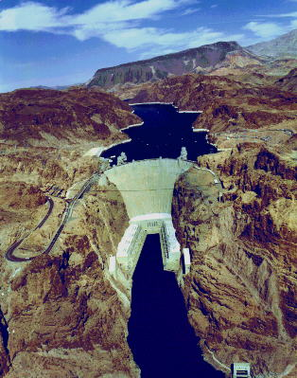
How we use water
We have achieved impressive engineering accomplishments to harness freshwater sources
60 % of the world’s largest 227 rivers have been strongly or moderately affected
Dams, canals, and diversions
Consumption of water in most of the world is unsustainable
We are depleting many sources of surface water and groundwater

Slide 2
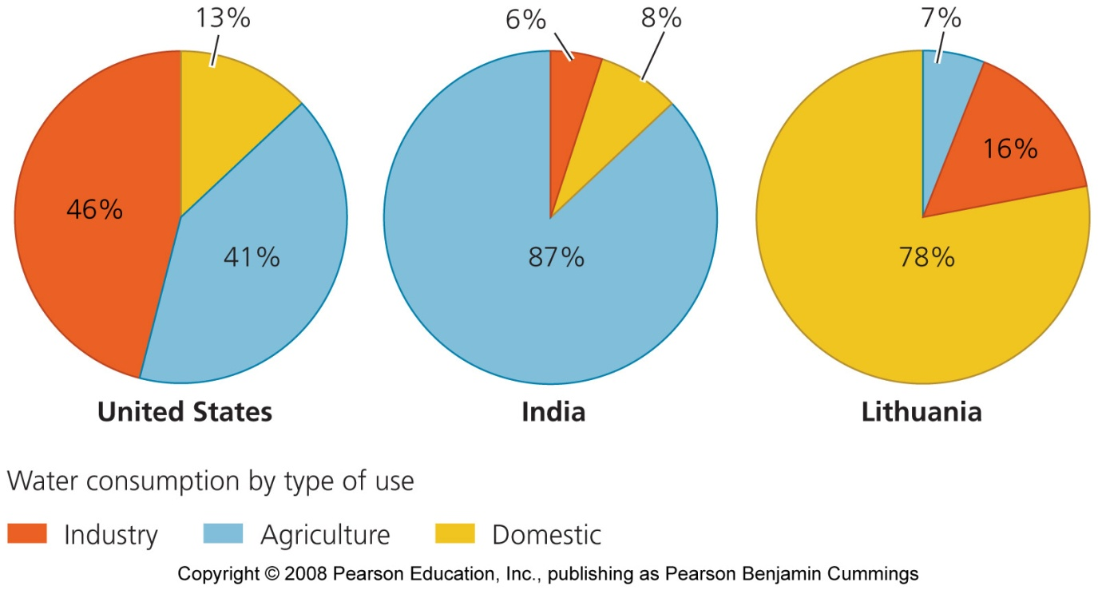
Water supplies houses, agriculture, and industry
Proportions of these three types of use vary dramatically among nations
Arid countries use water for agriculture
Developed countries use water for industry

Slide 3
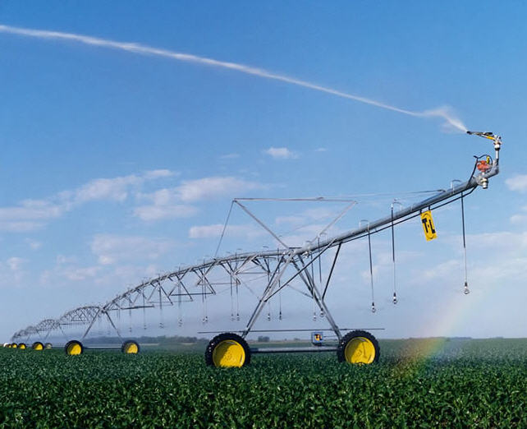
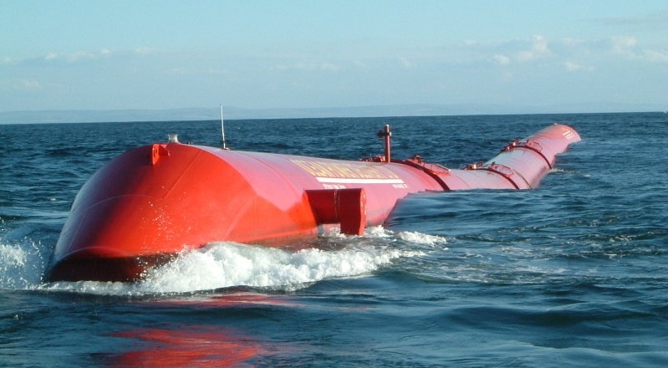
Different types of water use
Consumptive use = water is removed from an aquifer or surface water body, and is not returned
Non-consumptive use = does not remove, or only temporarily removes, water from an aquifer or surface water
Electricity generation at hydroelectric dams

Slide 4
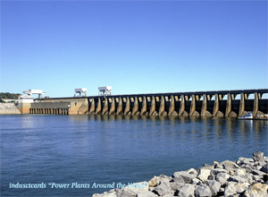
We have erected thousands of dams
Dam = any obstruction placed in a river or stream to block the flow of water so that water can be stored in a reservoir
To prevent floods, provide drinking water, allow irrigation, and generate electricity
45,000 large dams have been erected in more than 140 nations
Only a few major rivers remain undammed
In remote regions of Canada, Alaska, and Russia

Slide 5
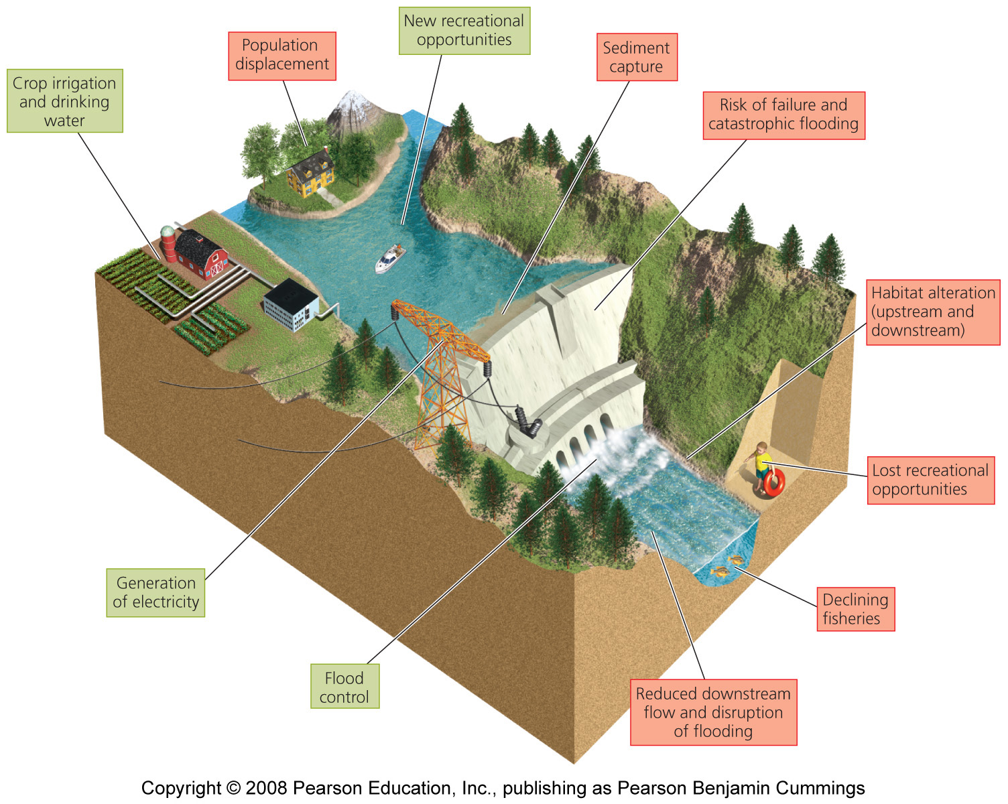
A typical dam

Slide 6
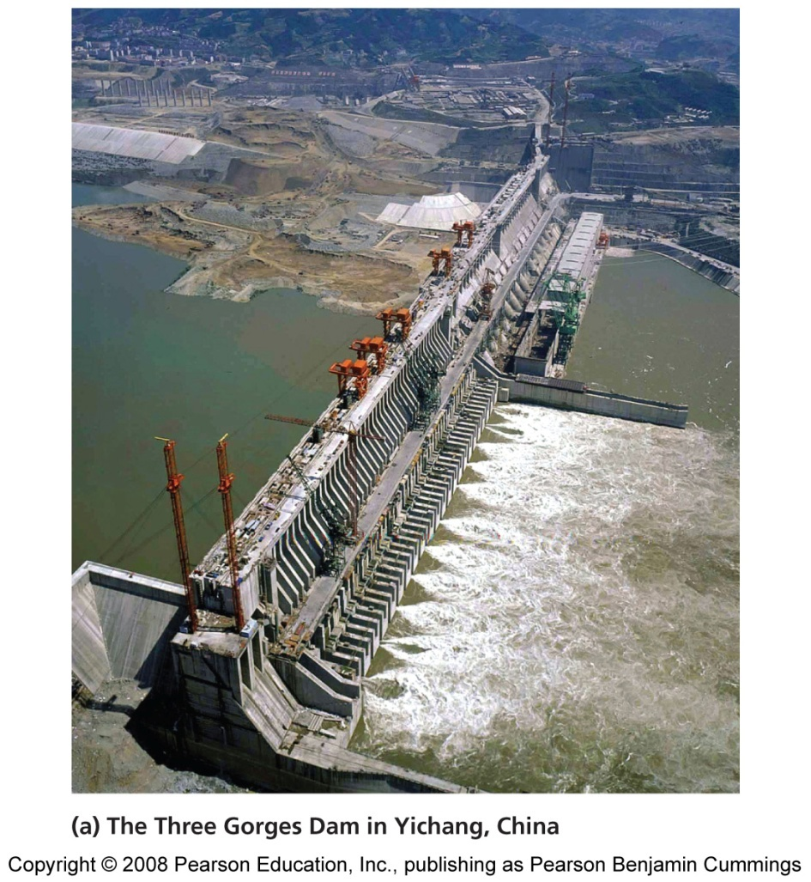
China’s Three Gorges Dam
The dam, on the Yangtze River, is the largest in the world
186 m (610 feet) high, 2 km (1.3 mi) wide
Its reservoir stretches for 616 km (385 mi)
Provides flood control, passage for boats, and electricity

Slide 7
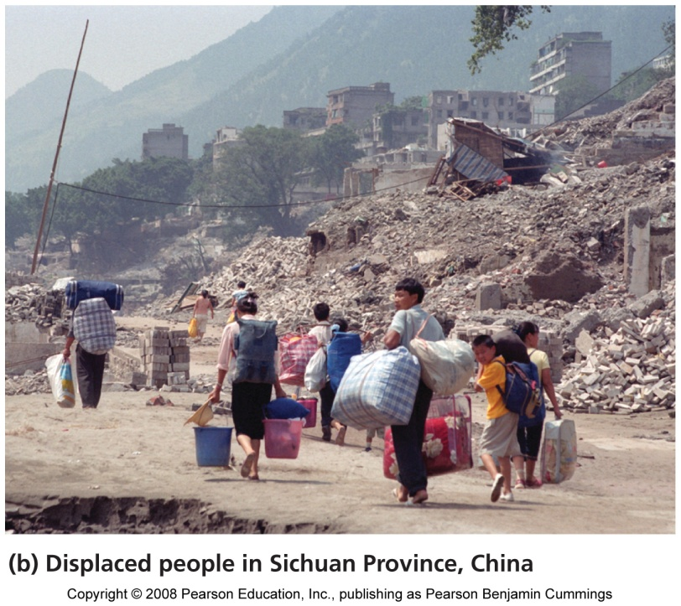
Drawbacks of the Three Gorges Dam
Cost $25 billion to build
Is flooding 22 cities and the homes of 1.13 million people
Submerging 10,000-year-old archaeological sites
Drowning farmland and wildlife habitat
Tidal marshes at the Yangtze’s mouth are eroding
Pollutants will be trapped
China will spend $5 billion to build sewage treatment plants

Slide 8
Benefits and drawbacks of dams
Benefits:
Power generation
Emission reduction
Crop irrigation
Drinking water
Flood control
Shipping
New recreational opportunities
Storage of water
Drawbacks:
Habitat alteration
Fisheries declines
Population displacement
Sediment capture
Disruption of flooding
Risk of failure
Lost recreational opportunities

Slide 9
Some dams are being removed
Some people feel that the cost of dams outweighs their benefits
They are pushing to dismantle dams
Rivers with dismantled dams
Have restored riparian ecosystems
Reestablished fisheries
Revived river recreation
500 dams have been removed in the U.S.
Property owners who opposed the removal change their minds once they see the healthy river

Slide 10
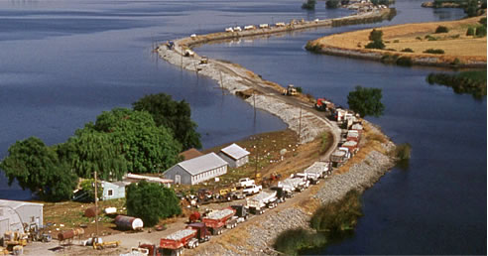
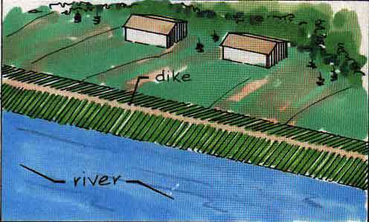
Dikes and levees are meant to control floods
Flooding is a normal, natural process
Floodwaters spread nutrient-rich sediments over large areas
Floods also do tremendous damage to property
Dikes and levees (long, raised mounds of earth) along the banks of rivers hold rising waters in channels
The U.S. Army Corps of Engineers has constructed thousands of miles of levees
Levees can make floods worse by forcing water to stay in channels and overflow

Slide 11
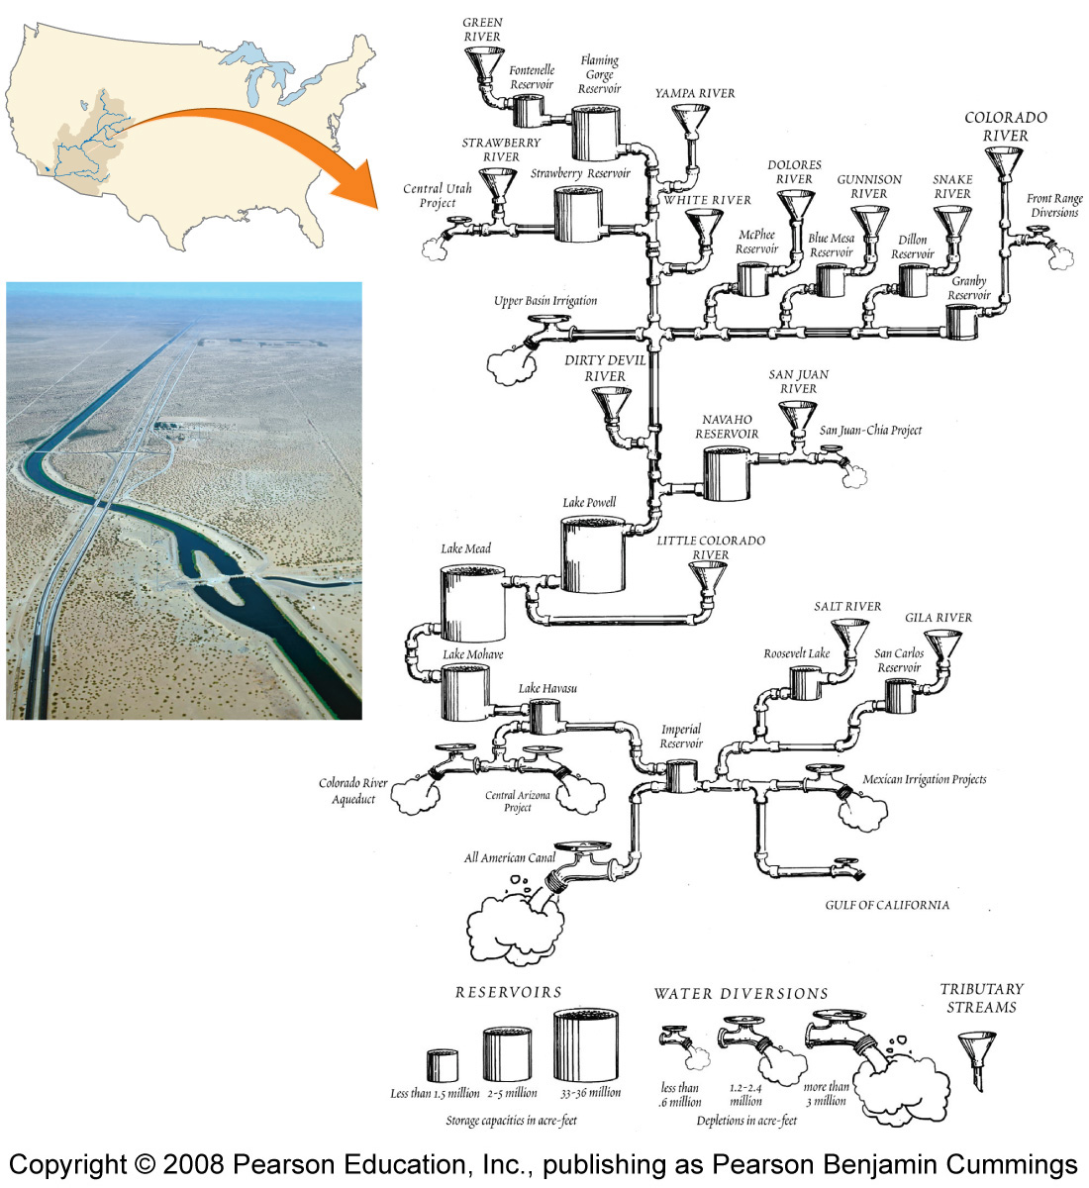
We divert – and deplete – surface water
People have long diverted water to farm fields, homes, and cities
What water is left after all the diversions comprises just a trickle into the Gulf of California
On some days, water does not reach the gulf
Diversion has drastically altered the river’s ecology

Slide 12
We divert – and deplete – surface water
People have long diverted water to farm fields, homes, and cities
What water is left after all the diversions comprises just a trickle into the Gulf of California
On some days, water does not reach the gulf
Diversion has drastically altered the river’s ecology

Slide 13
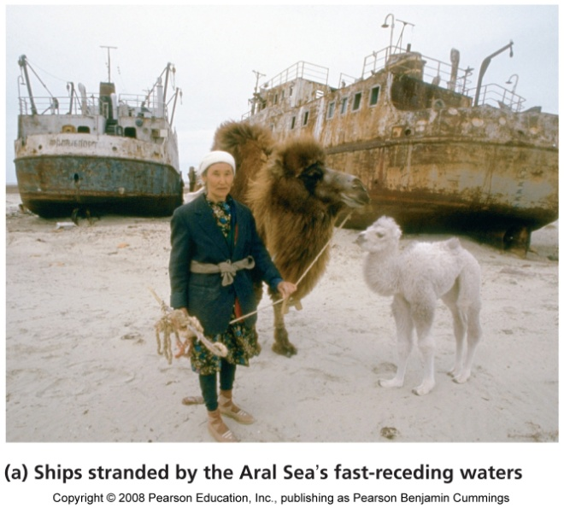
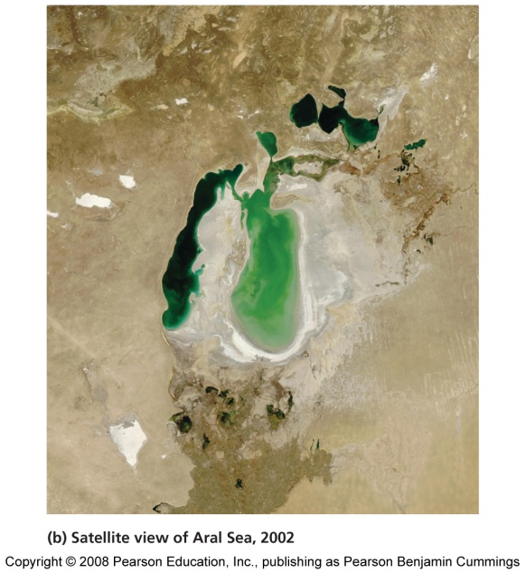
The Aral Sea
Once the fourth-largest lake on Earth
It has lost more than 80% of its volume in just 45 years
The two rivers leading into the Aral Sea were diverted to irrigate cotton fields
Consequences of a shrinking sea
60,000 fishing jobs are gone
Pesticide-laden dust from the lake bed is blown into the air
The cotton cannot bring back the region’s economy

Slide 14
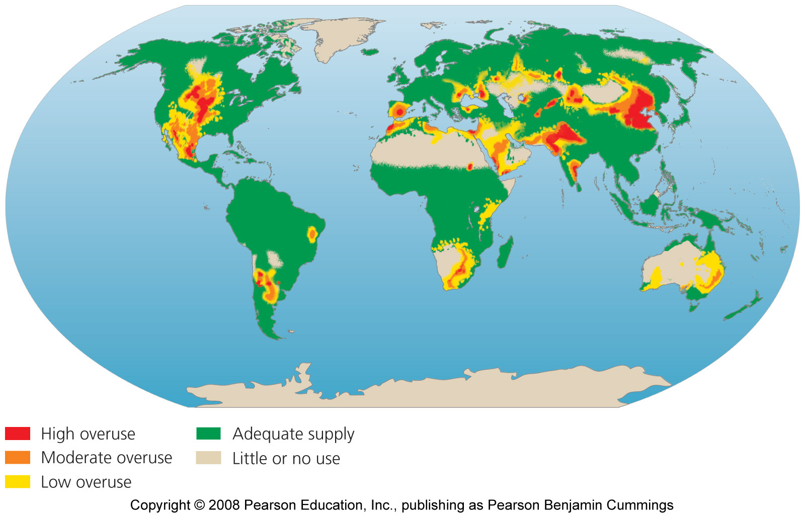
Areas where water use exceeds supply

Slide 15
Will we see a future of water wars?
Freshwater depletion leads to shortages, which can lead to conflict
261 major rivers cross national borders
Water is a key element in hostilities among Israel, Palestinians, and neighboring countries
Many nations have cooperated with neighbors to resolve disputes

Slide 16
Desalinization “makes” more water
Desalinization = the removal of salt from seawater or other water of marginal quality
Distilling = hastens evaporation and condenses the vapor
Reverse osmosis = forces water through membranes to filter out salts
Desalinization facilities operate mostly in the arid Middle East
It is expensive, requires fossil fuels, and produces concentrated salty water

Slide 17
The world’s largest reverse osmosis plant
Near Yuma, Arizona
Intended to reduce the salinity of irrigation runoff
Too expensive to operate and closed after 8 months

Slide 18
Agricultural demand can be reduced
Look first for ways to decrease agricultural demand
Lining irrigation canals
Low-pressure spray irrigation that spray water downward
Drip irrigation systems that target individual plants
Match crops to land and climate
Selective breeding and genetic modification to raise crops that require less water

Slide 19
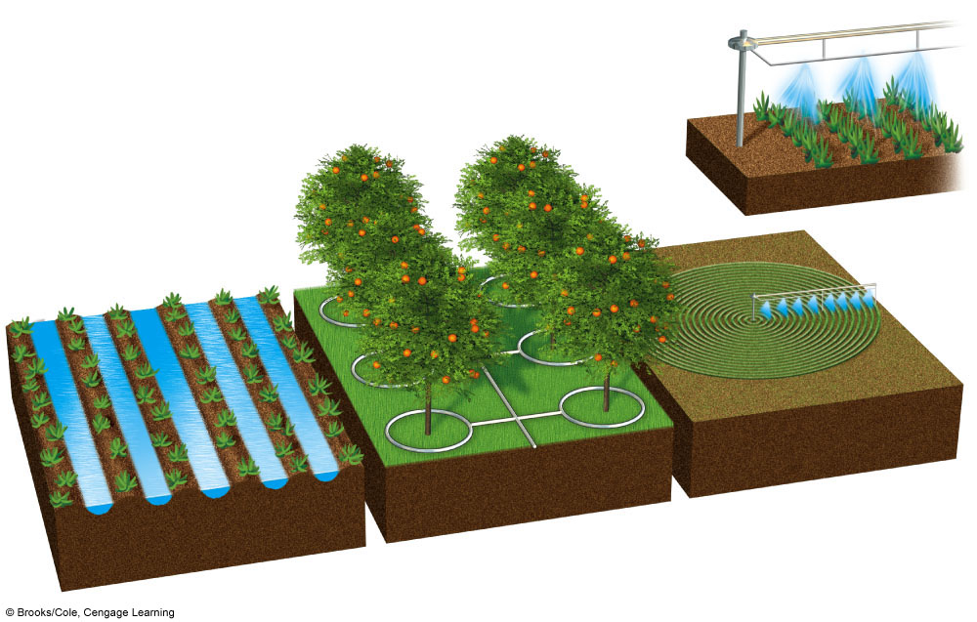
Major Irrigation Systems
Center pivot
(efficiency 80% with low-pressure sprinkler and 90–95% with LEPA sprinkler)
Drip irrigation
(efficiency 90–95%)
Gravity flow
(efficiency 60% and 80% with surge valves)
Above- or below-ground pipes or tubes deliver water to individual plant roots.
Water usually pumped from underground and sprayed from mobile boom with sprinklers.
Water usually comes from an aqueduct system or a nearby river.
Fig. 13-20, p. 335
Notes:
Figure 13.20
Major irrigation systems. Because of high initial costs, center-pivot irrigation and drip irrigation are not widely used. The development of new, low-cost, drip-irrigation systems may change this situation.

Slide 20
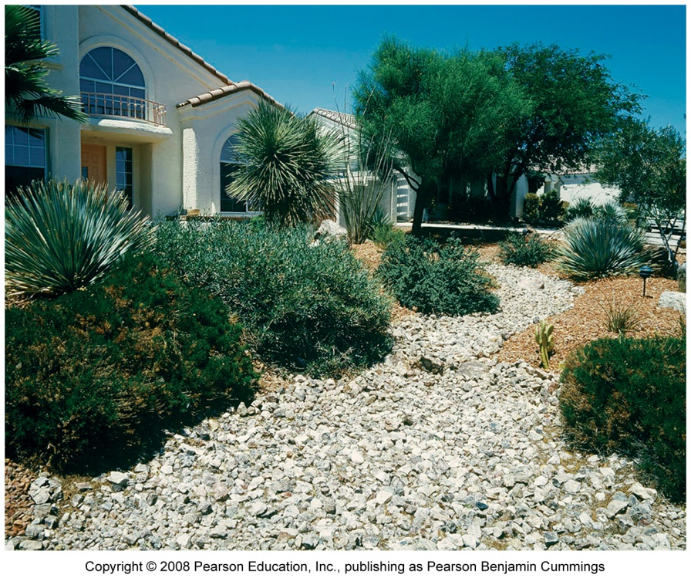
Residential demand can be reduced
Install low-flow faucets, showerheads, washing machines, and toilets
Water lawns at night, when evaporation is minimal
Eat less meat
Xeriscaping = landscaping using plants adapted to arid conditions

