Slide 1
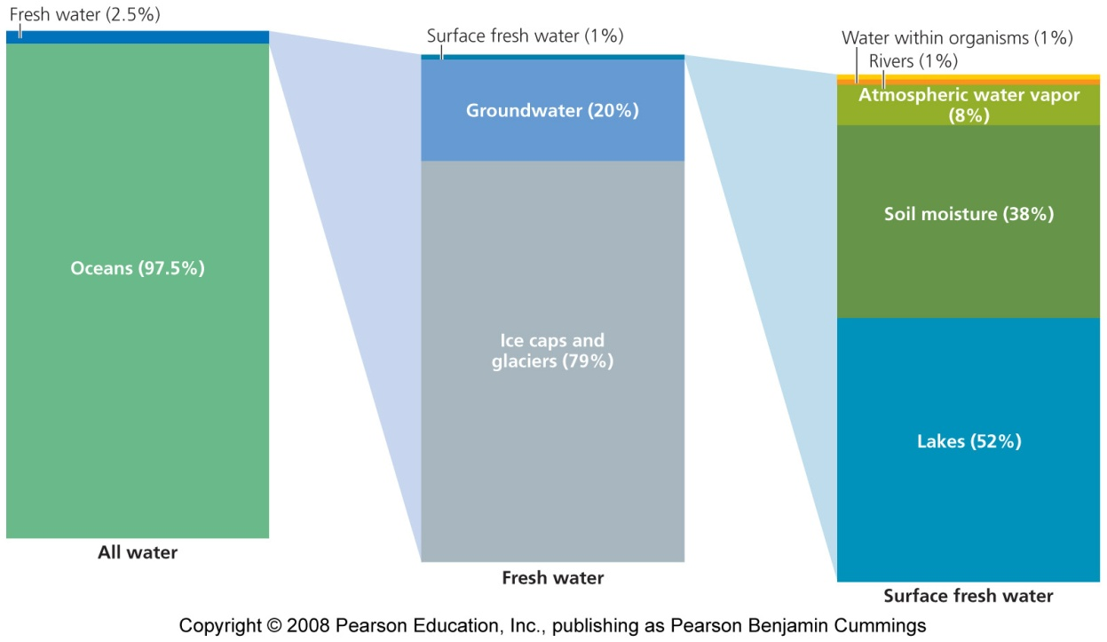
Freshwater systems
Water may seem abundant, but drinkable water is rare
Freshwater = relatively pure, with few dissolved salts
Only 2.5% of Earth’s water is fresh
Most freshwater is tied up in glaciers and ice caps

Slide 2
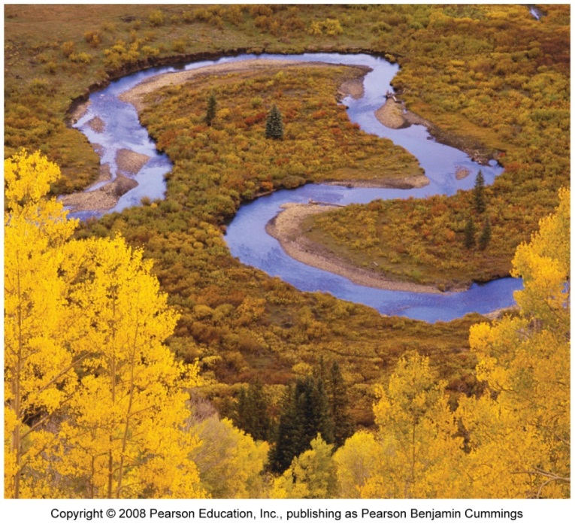
Rivers and streams wind through landscapes
Water from rain, snowmelt, or springs forms streams, creeks, or brooks
These merge into rivers, and eventually reaches the ocean
Tributary = a smaller river slowing into a larger one
Watershed = the area of land drained by a river and its tributaries
If there is a large bend in the river, the force of the water cuts through the land
Oxbow = an extreme bend in a river
Oxbow lake = the bend is cut off and remains as an isolated, U-shaped body of water

Slide 3
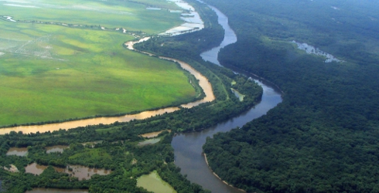
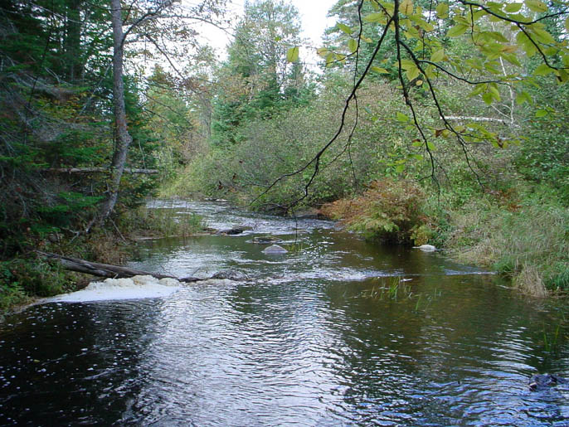
A river may shift course
Floodplain = areas nearest to the river’s course that are flooded periodically
Frequent deposition of silt makes floodplain soils fertile
Riparian = riverside areas that are productive and species-rich
It connects the upland zone to the aquatic zone, controlling the flow of water, sediment, nutrients, and organisms between the two.

Slide 4
Notes:
4

Slide 5
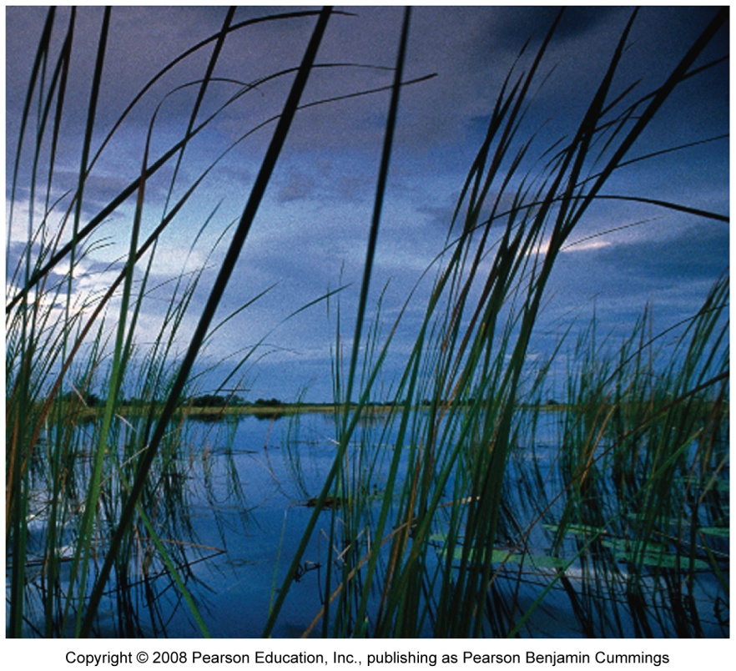
Wetlands include marshes, swamps, and bogs
Wetlands = systems that combine elements of freshwater and dry land
Freshwater marshes = shallow water allows plants to grow above the water’s surface
Swamps = shallow water that occurs in forested areas
Can be created by beavers
Bogs = ponds covered in thick floating mats of vegetation
A stage in aquatic succession

Slide 6
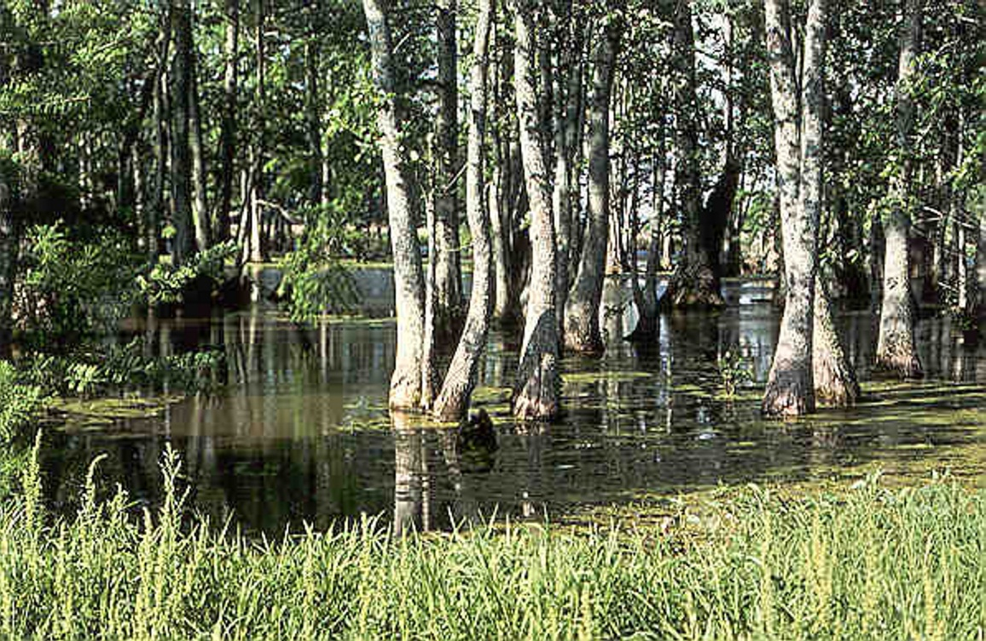
Wetlands are valuable
Wetlands are extremely valuable for wildlife
They slow runoff
Reduce flooding
Recharge aquifers
Filter pollutants
People have drained wetlands, mostly for agriculture
Southern Canada and the U.S. have lost more than half of their wetlands

Slide 7
Lakes and ponds are ecologically diverse
Lakes and ponds are bodies of open, standing water
Littoral zone = region ringing the edge of a water body
Benthic zone = extends along the entire bottom of the water body
Home to many invertebrates
Limnetic zone = open portions of the lake or pond where the sunlight penetrates the shallow waters
Profundal zone = water that sunlight does not reach
Supports fewer animals because there is less oxygen

Slide 8
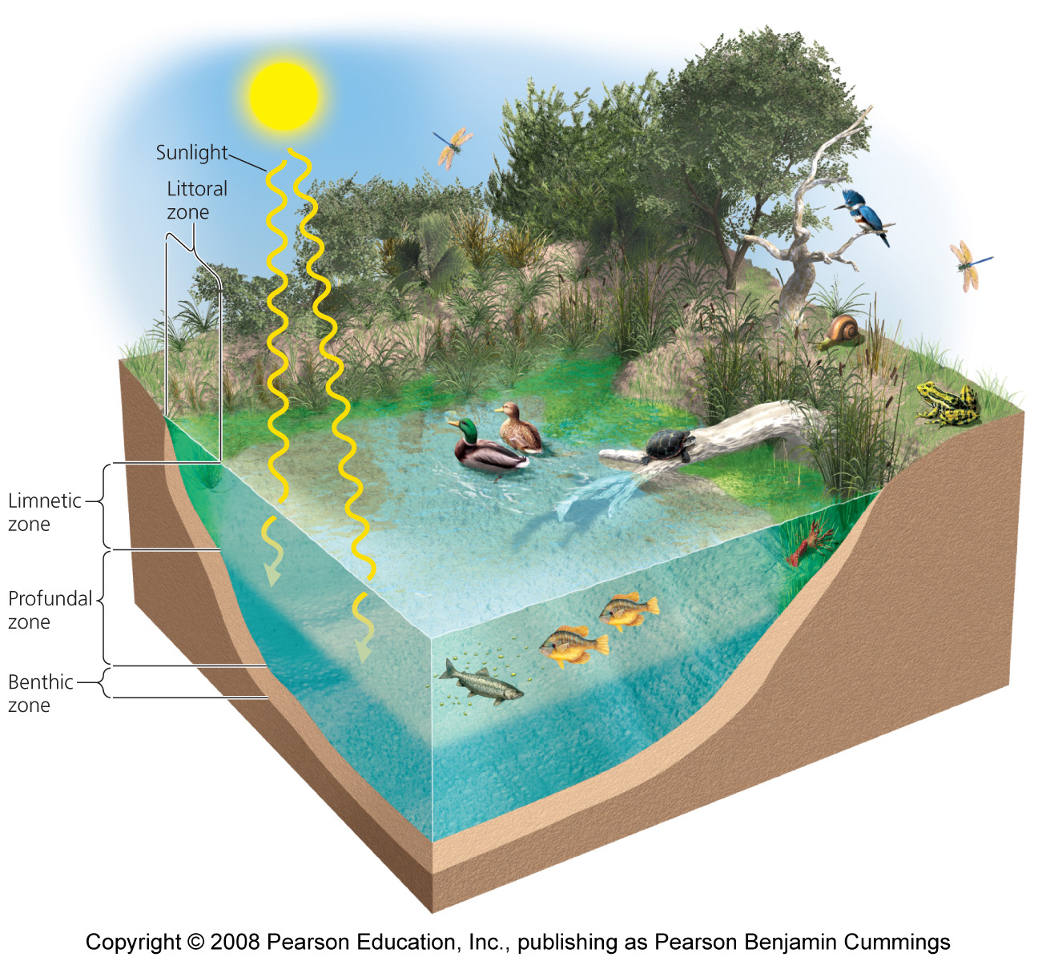
A typical lake

Slide 9
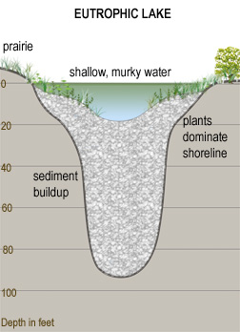
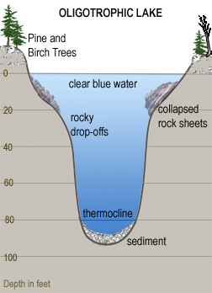
Lakes vary in their nutrients and oxygen
Oligotrophic lakes and ponds = have low nutrient and high oxygen conditions
Eutrophic lakes and ponds = have high nutrient and low oxygen conditions

Slide 10
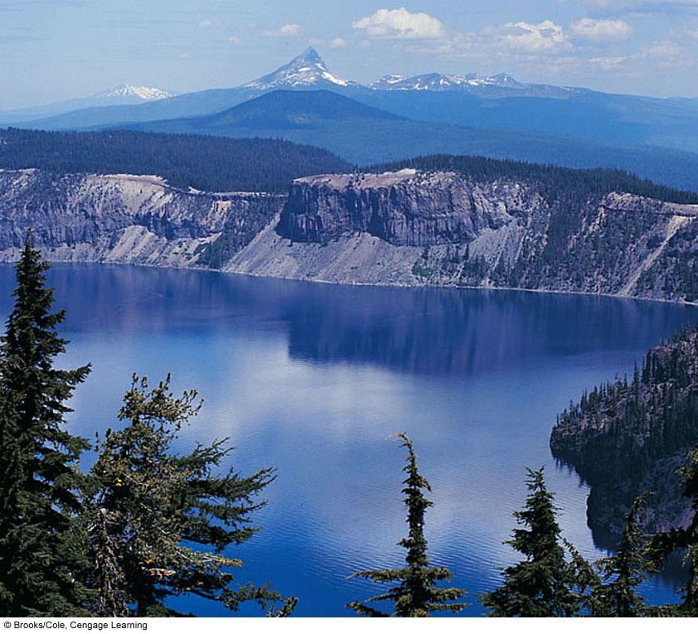
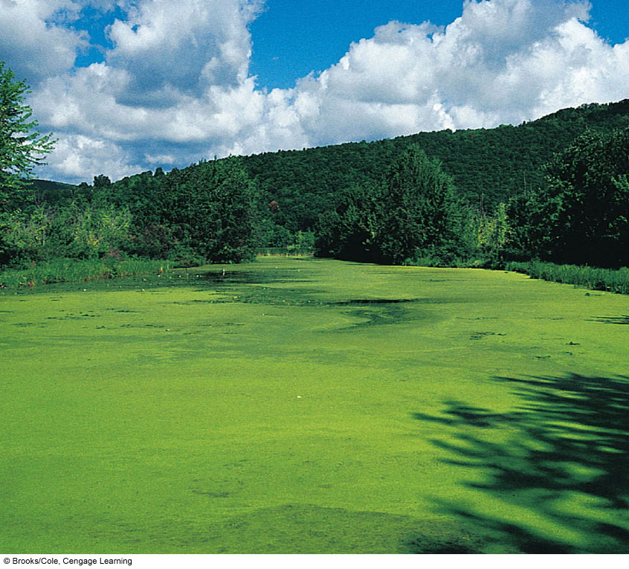
The Effect of Nutrient Enrichment on a Lake
Notes:
Crater Lake in Oregon is an example of an oligotrophic lake that is low in nutrients. The lake on the right, found in western New York State, is a eutrophic lake. Because of an excess of plant nutrients, its surface is covered with mats of algae and cyanobacteria.
10

Slide 11
Groundwater plays a key role
Groundwater = any precipitation that does not evaporate, flow into waterways, or gets taken up by organisms
Groundwater makes up one fifth of the Earth’s freshwater supply
Aquifers = Porous sponge-like formations of rock, sand, or gravel that hold groundwater
Zone of aeration = pore spaces are partially filled with water
Zone of saturation = spaces are completely filled with water
Water table = boundary between the two zones
Aquifer recharge zone = any area where water infiltrates Earth’s surface and reaches aquifers

Slide 12
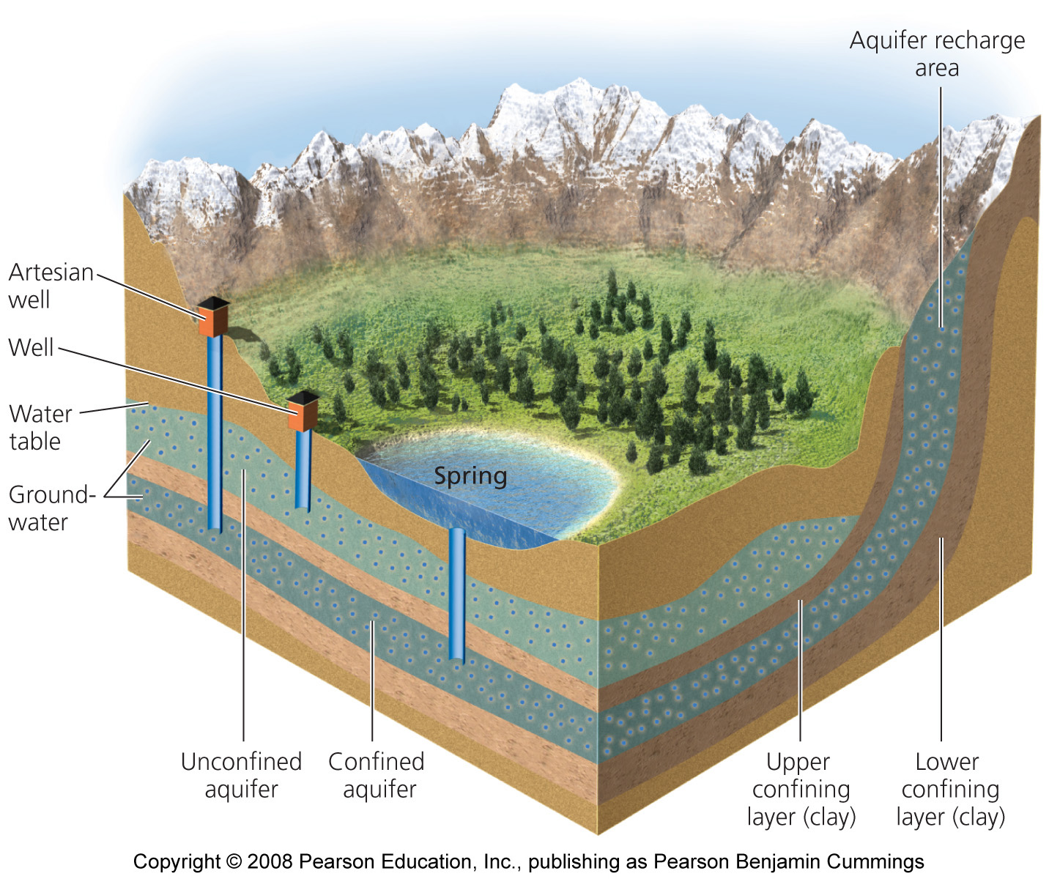
A typical aquifer

Slide 13
There are two categories of aquifers
Confined or artesian = water-bearing, porous rocks are trapped between layers of less permeable substrate (i.e., clay)
Is under a lot of pressure
Unconfined aquifer = no upper layer to confine it
Readily recharged by surface water
Groundwater becomes surface water through springs or human-drilled wells
Groundwater may be ancient: the average age is 1,400 years

Slide 14
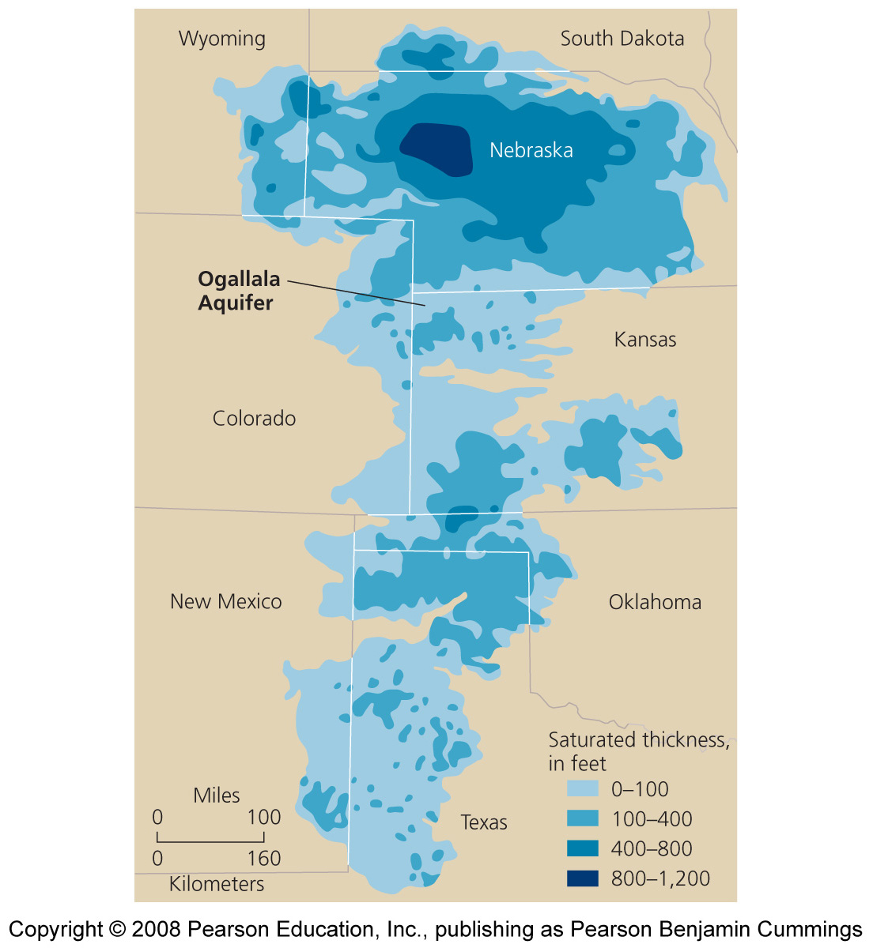
The Ogallala Aquifer
The world’s largest known aquifer
Underlies the Great Plains of the U.S.
Its water has allowed farmers to create the most bountiful grain-producing region in the world

Slide 15
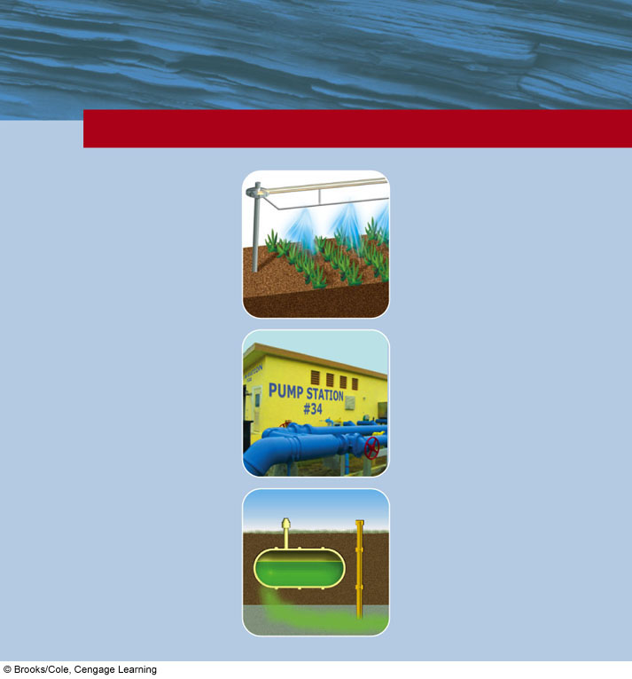
TRADE-OFFS
Withdrawing Groundwater
Advantages
Disadvantages
Useful for drinking and irrigation
Aquifer depletion from overpumping
Sinking of land (subsidence) from overpumping
Available year-round
Exists almost everywhere
Aquifers polluted for decades or centuries
Renewable if not overpumped or contaminated
Saltwater intrusion into drinking water supplies near coastal areas
Reduced water flows into surface waters
No evaporation losses
Increased cost and contamination from deeper wells
Cheaper to extract than most surface waters
Fig. 13-7, p. 321
Notes:
Figure 13.7
Advantages and disadvantages of withdrawing groundwater. Question: Which two advantages and which two disadvantages do you think are the most important? Why?

Slide 16
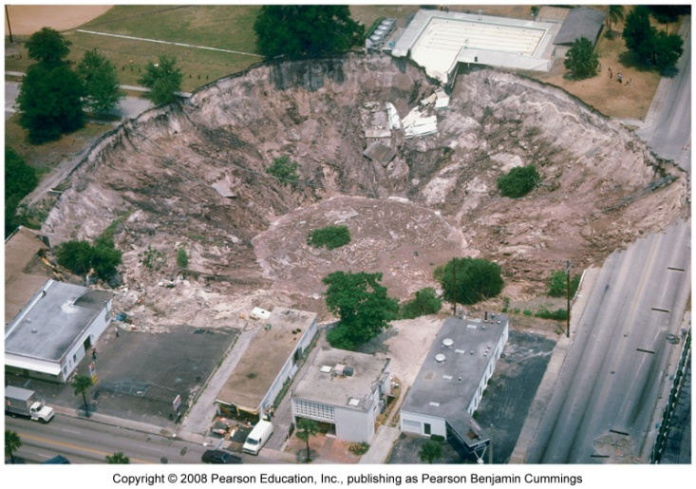
We are depleting groundwater
Groundwater is easily depleted
Aquifers recharge slowly
1/3 of world population relies on groundwater
As aquifers become depleted
Water tables drop
Salt water intrudes in coastal areas
Sinkholes = areas where ground gives way unexpectedly
Some cities (Venice, Mexico City) are slowly sinking
Wetlands dry up

Slide 17
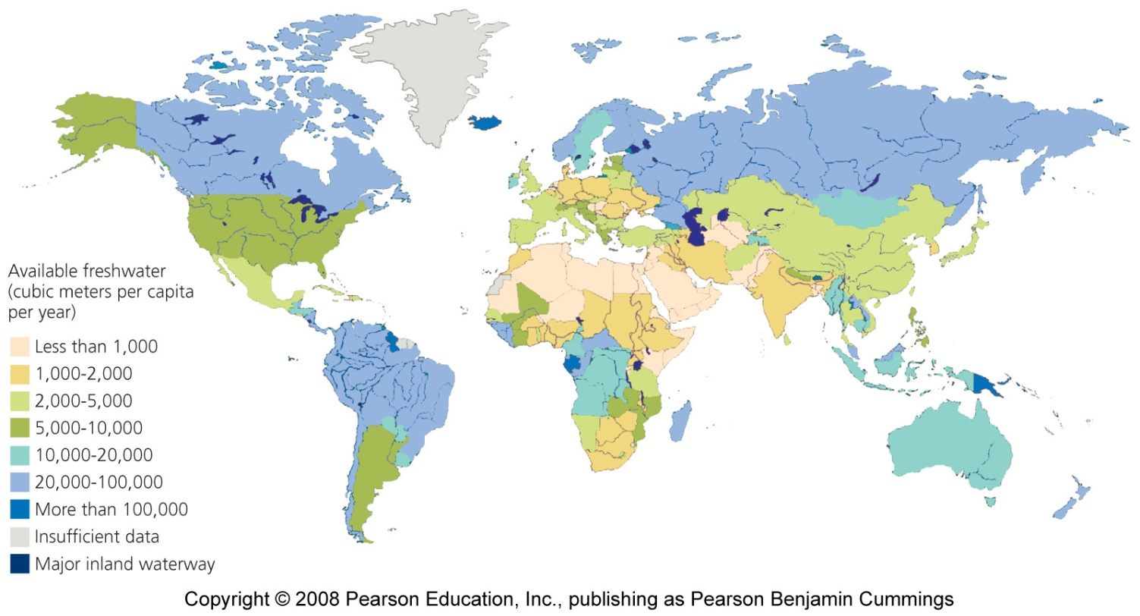
Water is unequally distributed across Earth’s surface
Different regions possess vastly different amounts of groundwater, surface water, and precipitation
Many areas with high population density are water- poor and face serious water shortages

Slide 18
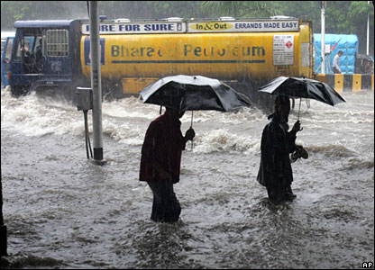
Water is distributed unevenly in time, too
Monsoon seasons bring concentrated storms
Half a region’s annual rain may fall in a few hours
People erect dams to store water

Slide 19
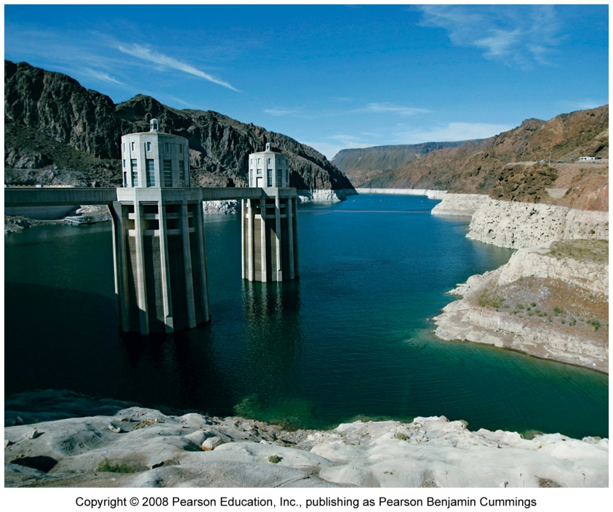
Climate change will cause water shortages
Climate change will cause
Altered precipitation patterns
Melting glaciers
Early season runoff
Intensified droughts
Flooding
Increasing probability that there will be still less water for more people

