Slide 1
The Essential 30 (and two new things)

Slide 2
1) Acid Deposition

Slide 3
Acid Deposition
- All forms of acid precipitation, pH < 5.6
- Release ions from soil, damage water, damage buildings, headstones

Slide 4
Acid Deposition
Biological diversity

Slide 5
Acid Deposition
Biological diversity
- total # of species

Slide 6
Acid Deposition
Biological diversity
3) Biomagnification

Slide 7
Acid Deposition
Biological diversity
3) Biomagnification
ex: DDT, Mercury
(1) stored in tissue (2) Persistent (fat soluble)

Slide 8
Acid Deposition
Biological diversity
3) Biomagnification
4) Bioremediation

Slide 9
Acid Deposition
Biological diversity
3) Biomagnification
4) Bioremediation - Using microorganisms to remediate organic waste
- ex: Using microorganisms to clean up oil spills (Exxon Valdez)

Slide 10
Acid Deposition
Biological diversity
3) Biomagnification
4) Bioremediation
5) 2nd Law Thermodynamics

Slide 11
Acid Deposition
Biological diversity
3) Biomagnification
4) Bioremediation
5) 2nd Law Thermodynamics - Energy in a system moves toward entropy - Energy is lost as heat during conversions

Slide 12
6) Carrying Capacity

Slide 13
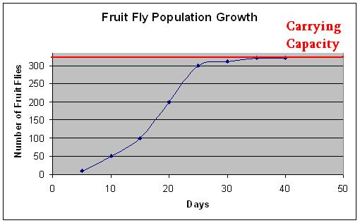
6) Carrying Capacity - maximum # of individuals that can be sustained by an ecosystem.

Slide 14
Carrying Capacity
Rule of 70

Slide 15
Carrying Capacity
Rule of 70 - Determine doubling time:
70/growth rate
- World growth rate is 1.2%

Slide 16
Carrying Capacity
Rule of 70
CFC

Slide 17
Carrying Capacity
Rule of 70
CFC - Aerosols - Depletes stratospheric ozone layer - UV light can cause cancer, can damage chlorophyll in leaves
- Montreal Protocol

Slide 18
Carrying Capacity
Rule of 70
CFC
Eutrophication

Slide 19
Carrying Capacity
Rule of 70
CFC
Eutrophication - Nutrient pollution - Algal blooms increase, when they die they are decomposed by bacteria which use up the oxygen in the water source - Hypoxia

Slide 20
Carrying Capacity
Rule of 70
CFC
Eutrophication
Greenhouse Gases (top 3)

Slide 21
Carrying Capacity
Rule of 70
CFC
Eutrophication
Greenhouse Gases (top 3) - Carbon Dioxide, Water Vapor, Methane - Absorb heat reflecting off the surface of the earth and send back to earth - Helps to heat the surface

Slide 22
11) Nitrogen Fixation vs. Denitrification

Slide 23
11) Nitrogen Fixation vs. Denitrification - Fixation: N₂ + Bacteria → NH₃
- Nitrogen-fixing bacteria (legumes)
- Denitrification: NO₃ + Bacteria → N₂
- Denitrifying bacteria (soil)

Slide 24
Nitrogen Fixation vs. Denitrification
I = P x A x T

Slide 25
Nitrogen Fixation vs. Denitrification
I = P x A x T - Measure environmental impact I = impact P = population A = affluence T = technology

Slide 26
Nitrogen Fixation vs. Denitrification
I = P x A x T
13) Tropospheric Ozone

Slide 27
Nitrogen Fixation vs. Denitrification
I = P x A x T
Tropospheric Ozone
NO₂ + UV →NO + O
O + O₂ → O₃
- Secondary pollutant causing human effects such as: coughing, damage to lungs

Slide 28
Nitrogen Fixation vs. Denitrification
I = P x A x T
Tropospheric Ozone
14) Kyoto Protocol

Slide 29
Nitrogen Fixation vs. Denitrification
I = P x A x T
Tropospheric Ozone
14) Kyoto Protocol - Lower greenhouse gases (such as CO₂) - America did NOT ratify (economics)

Slide 30
Nitrogen Fixation vs. Denitrification
I = P x A x T
Tropospheric Ozone
14) Kyoto Protocol
15) Photochemical Smog

Slide 31
Nitrogen Fixation vs. Denitrification
I = P x A x T
Tropospheric Ozone
14) Kyoto Protocol
Photochemical Smog
NO_{x} + UV Light + Particulates → Smog
- Brown Smog
- Big cities, cars, thermal inversions - Can lead to formation of acid deposition/ stratospheric ozone

Slide 32
16) SO_{x} vs. NO_{x}

Slide 33
16) SO_{x} vs. NO_{x} - sulfur oxides → from coal burning
- industrial smog, sulfuric acid
- nitric oxides → from cars (oil burning)
- photochemical smog, nitric acid

Slide 34
16) SO_{x} vs. NO_{x}
17) Logistic vs. Exponential Growth

Slide 35
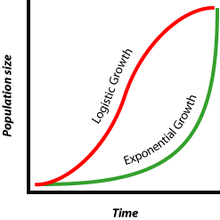
16) SO_{x} vs. NO_{x}
17) Logistic vs. Exponential Growth

Slide 36
16) SO_{x} vs. NO_{x}
17) Logistic vs. Exponential Growth
18) Secondary Succession

Slide 37
16) SO_{x} vs. NO_{x}
17) Logistic vs. Exponential Growth
18) Secondary Succession - After disturbance that leaves soil
Grasses → Shrubs → Aspens → Pines → Hardwood Trees
Pioneer Fast Species

Slide 38
16) SO_{x} vs. NO_{x}
17) Logistic vs. Exponential Growth
18) Secondary Succession
19) Tragedy of the Commons

Slide 39
16) SO_{x} vs. NO_{x}
17) Logistic vs. Exponential Growth
18) Secondary Succession
19) Tragedy of the Commons - resources which are open to unregulated exploitation will eventually be depleted

Slide 40
16) SO_{x} vs. NO_{x}
17) Logistic vs. Exponential Growth
18) Secondary Succession
19) Tragedy of the Commons
20) Waste Water Treatment

Slide 41
16) SO_{x} vs. NO_{x}
17) Logistic vs. Exponential Growth
18) Secondary Succession
19) Tragedy of the Commons
20) Waste Water Treatment - Primary: physical removal (screens, settling) - Secondary: biological removal - Tertiary: UV light

Slide 42
21) LD-50

Slide 43
21) LD-50 - Lethal dose to 50% of test population

Slide 44
21) LD-50
22) Keystone vs. Exotic vs. Invasive species

Slide 45
21) LD-50
22) Keystone vs. Exotic vs. Invasive species - Keystone – exerts a disproportionate influence on an ecosystem example: Sea Otters
- Exotic – an introduced species example: Kudzu
- Invasive – introduced species which (1) reproduces quickly and (2) no natural predators
example: Kudzu, Zebra Mussels

Slide 46
21) LD-50
22) Keystone vs. Exotic vs. Invasive species
23) Integrated Pest Management

Slide 47
21) LD-50
22) Keystone vs. Exotic vs. Invasive species
23) Integrated Pest Management - agricultural management practice that is a combination of biological control and pesticides

Slide 48
21) LD-50
22) Keystone vs. Exotic vs. Invasive species
23) Integrated Pest Management
24) Primary and Secondary Air Pollutants

Slide 49
21) LD-50
22) Keystone vs. Exotic vs. Invasive species
23) Integrated Pest Management
24) Primary and Secondary Air Pollutants - 1º → directly emitted (NO_{x}, SO_{x}, C)
- 2º → created in atmosphere (usually through interaction with UV and/or water) examples: Ozone, Acid Deposition

Slide 50
21) LD-50
22) Keystone vs. Exotic vs. Invasive species
23) Integrated Pest Management
24) Primary and Secondary Air Pollutants
25) Passive Solar Design

Slide 51
21) LD-50
22) Keystone vs. Exotic vs. Invasive species
23) Integrated Pest Management
24) Primary and Secondary Air Pollutants
25) Passive Solar Design - using solar energy in an indirect way examples: south-facing windows, stone floors, thick walls

Slide 52
26) Green Revolution

Slide 53
26) Green Revolution - Movement and increase in ag. technology in order to feed the world’s growing population (1) industrialization, (2) ag tech (3) GMO’s

Slide 54
26) Green Revolution
27) GMOs

Slide 55
26) Green Revolution
27) GMOs
- Genetically modified organisms - Recombinant DNA technology - traits: pesticide resistance, drought resistance, high yield, rapid growth ex: Bt tomatoes, soybeans, corn

Slide 56
26) Green Revolution
27) GMOs
28) 5 Types of Pollution

Slide 57
26) Green Revolution
27) GMOs
28) 5 Types of Pollution - Sediment, Nutrient, Thermal, Toxic Chemical, Pathogen

Slide 58
26) Green Revolution
27) GMOs
28) 5 Types of Pollution
29) Three Gorges Dam / Ogallala Aquifer

Slide 59
26) Green Revolution
27) GMOs
28) 5 Types of Pollution
29) Three Gorges Dam / Ogallala Aquifer - Three Gorges → World’s largest Dam, China Displaced thousands of people, hydroelectric
- Ogallala → World’s largest aquifer (South Dakota down to Texas) Is being rapidly depleted by irrigation

Slide 60
26) Green Revolution
27) GMOs
28) 5 Types of Pollution
29) Three Gorges Dam / Ogallala Aquifer
30) Demographic Transition

Slide 61
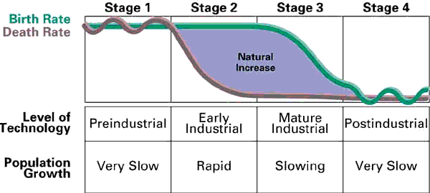
30) Demographic Transition

Slide 62
Two New Things
31) BOD – biological oxygen demand The amount of oxygen needed to breakdown organic matter
Higher BOD = Less Oxygen = More Polluted

Slide 63
Two New Things
32) Gross vs. Net Primary Productivity
NPP = GPP – Respiration
GPP = total rate of photosynthesis
NPP = energy to be passed to the first trophic level

